Slide 1
The Dark Energy Survey: an overview
Rogerio Rosenfeld
IFT-UNESP
ICTP-SAIFR
LIneA

Slide 2
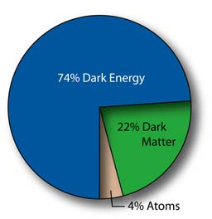
Introduction
We know that we don’t know what the universe is made of:

Slide 3
Introduction
Cosmological information can be obtained from observations related to two main types of effects:
Geometry and Growth of structures

Slide 4
Introduction
1. Geometry: average evolution of the universe
- specified by one function: scale factor a(t)
- determines measurement of large scale distances,
velocities and acceleration
measured through standard candles (SNIa’s) and
standard rulers (position of CMB peak, BAO peak,...)

Slide 5
Introduction
2. Growth: evolution of perturbations in the universe
determines how small inhomogeneities grow to give rise to the large scale structure of the universe
- specified by so-called growth function
measured through studies of the distribution of matter in the universe

Slide 6
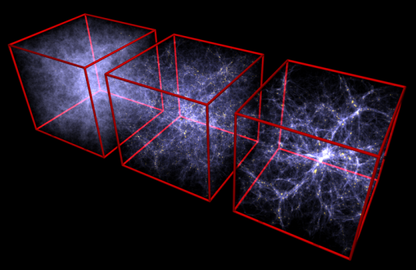
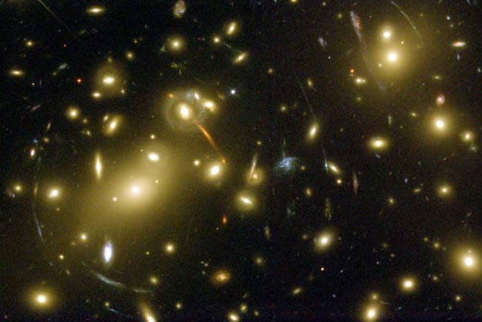
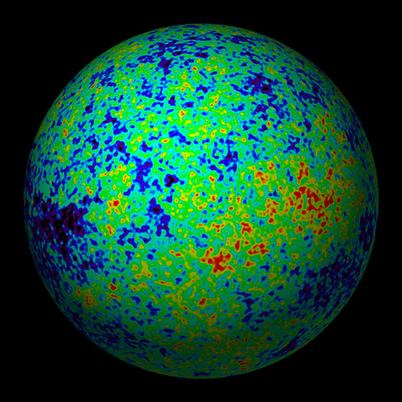
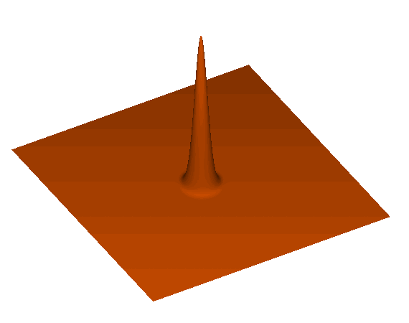
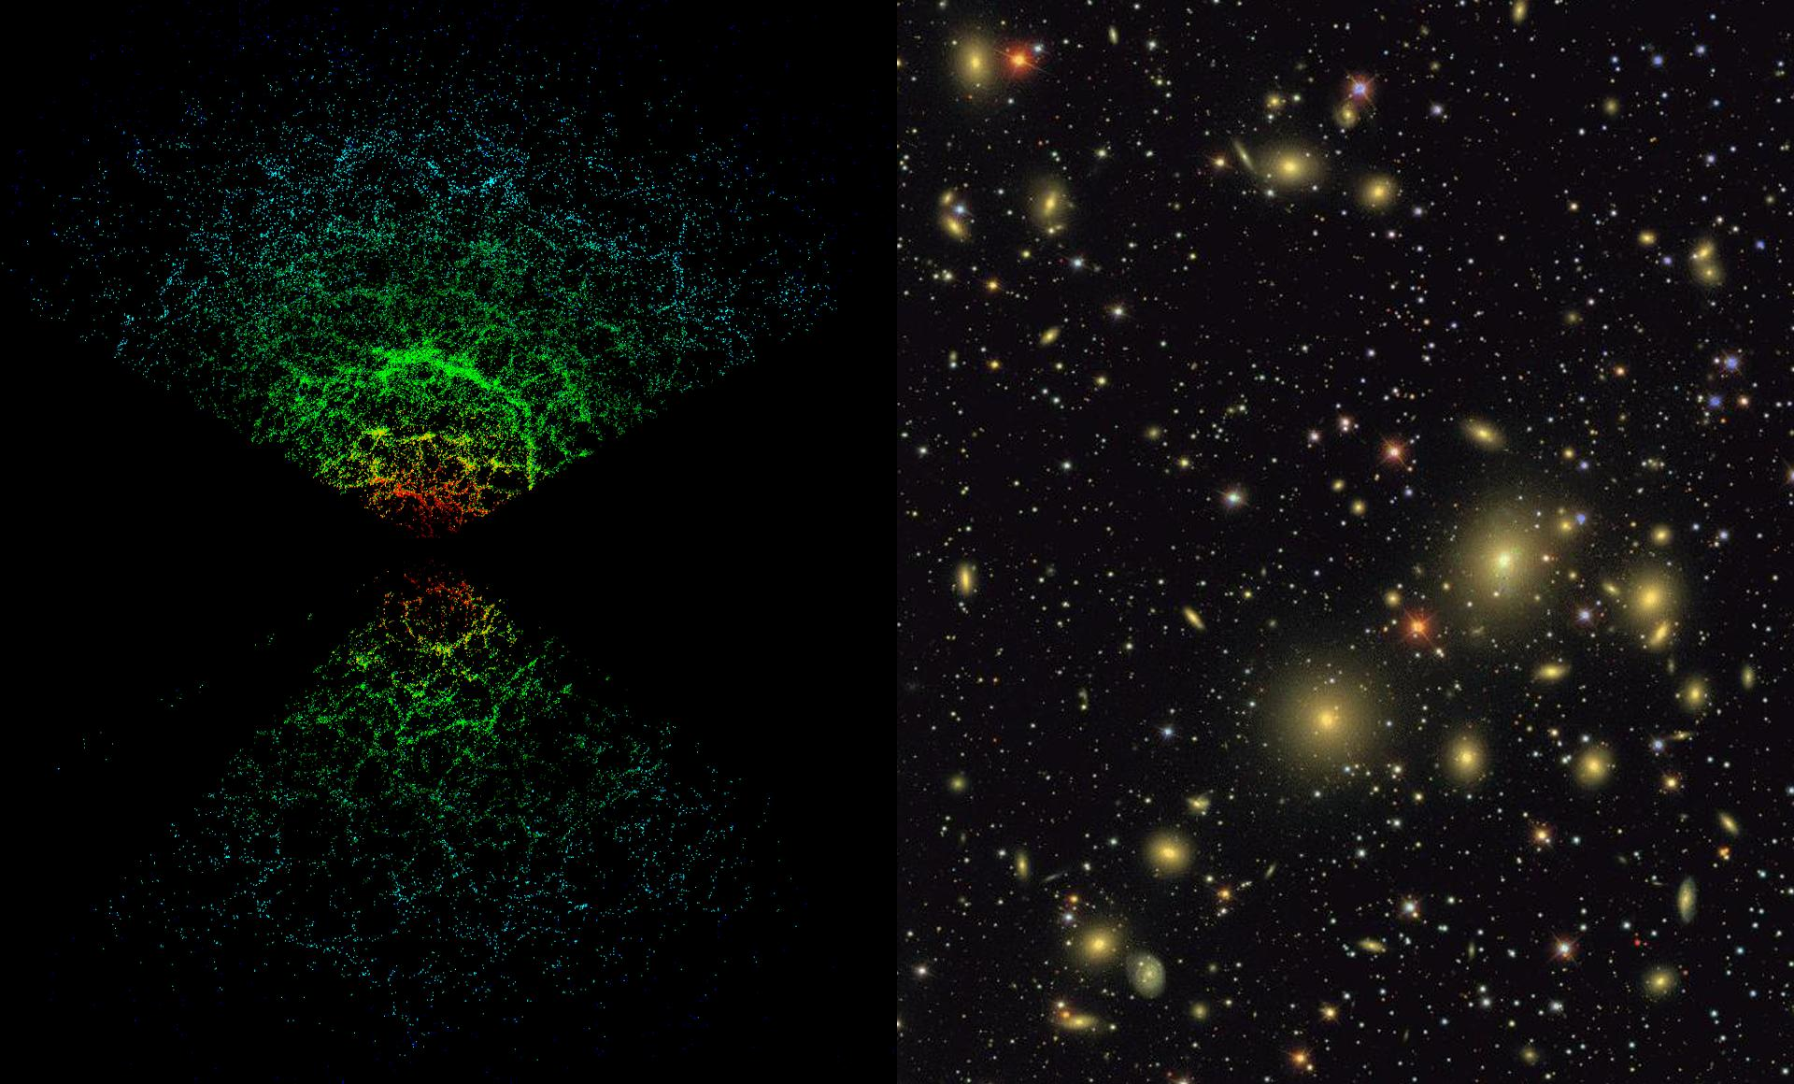
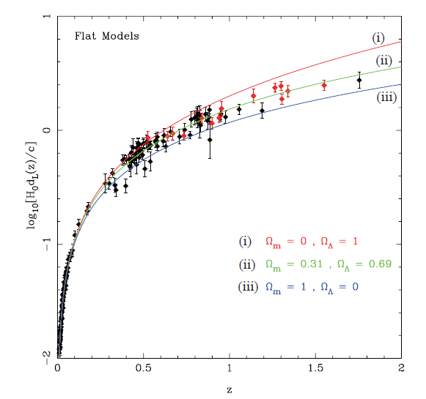
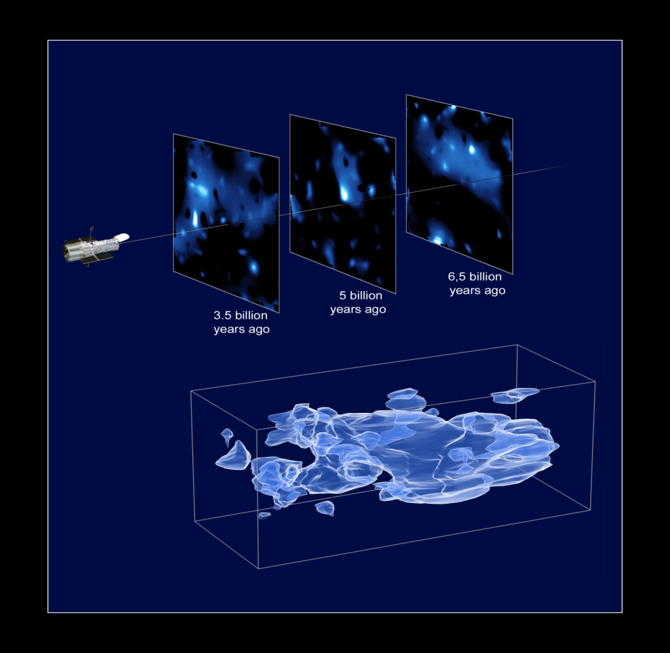
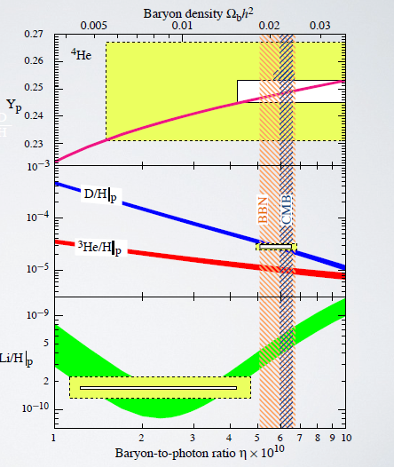
Cosmological probes
Eisenstein
HST

Slide 7
Cosmological probes
Dark Energy Survey will measure cosmological
parameters by using 4 complementary probes
(sensitive to both geometry and growth):
Large scale structure
Weak gravitational lensing
Cluster of galaxies (+ SPT clusters)
Supernovae
Obs.: DES will also make non-cosmological studies:
Milky Way, galaxy evolution, QSO, …

Slide 8
DES Project
The DES Collaboration: Josh Frieman – Project Director
US:
Fermilab, UIUC/NCSA, U. of Chicago, LBNL, NOAO, Argonne, U. of Michigan, Ohio Sate, U of Penn, Texas A&M, Santa Cruz, SLAC, Stanford
United Kingdom:
UCL, Cambridge, Edinburgh, Portsmouth, Sussex, Nottingham
Spain:
IEEC/CSIC, IFAE, CIEMAT
DES-Brazil Consortium - LIneA
Germany:
Munich—Universitäts-Sternwarte München, Ludwig-Maximilians Universität
Switzerland: ETH
200+ scientists
27 institutions
$40M project
http://www.darkenergysurvey.org/

Slide 9
DES Project

Slide 10
DES Science Committee
SC Chair: O. Lahav
Large Scale Structure: E. Gaztanaga & W. Percival
Weak Lensing: S. Bridle & B. Jain
Clusters: J. Mohr & C. Miller
SN Ia: M. Sako & B. Nichol
Photo-z: F. Castander & H. Lin
Simulations: G. Evrard & A. Kravtsov
Galaxy Evolution: D. Thomas & R. Wechsler
QSO: P. Martini & R. McMahon
Strong Lensing: L. Buckley-Geer & M. Makler
Milky Way: B. Santiago & B. Yanny
Theory & Combined Probes: S. Dodelson & J. Weller
+ Spectroscopic task force: F. Abdalla & A. Kim
+ Ad-hoc Committees

Slide 11
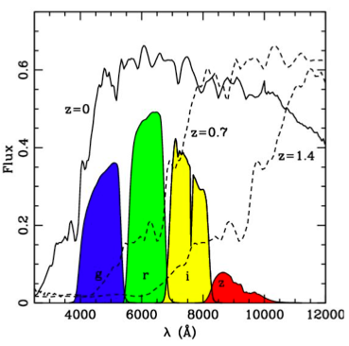
DES Project
Survey of 5000 deg² (~ 1/8 of the sky)
300 millions of galaxies up to z~1.4
(+ 100,000 clusters + 4,000 SNs)
Photometric redshift with 5 filters
Project initiated in 2003
Observations from 09/2012-02/2017 (5x105 nights)

Slide 12
DES Project
3 Construction Projects:
DECam (hosted by FNAL; DOE supported)
Data Management System (NCSA; NSF support)
CTIO Facilities Improvement Project (NSF/NOAO)

Slide 13
DES Project Timeline
NOAO Blanco Announcement of Opportunity 2003
DECam R&D 2004-8
Camera construction 2008-11
Final testing, integration now on-going
Shipping components to Chile 2011
Installation on telescope begins early 2012
First light DECam on telescope September 2012
Commissioning and Science Verification: Fall 2012/Spring 2013
Survey operations begin: Fall 2012

Slide 14
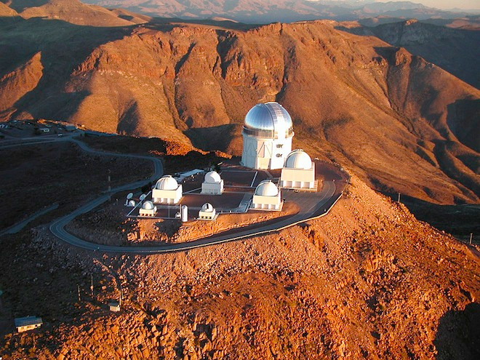
DES Project Site
DES site: 4m Blanco telescope at the Cerro Tololo Inter-American Observatory (CTIO) in Chile

Slide 15
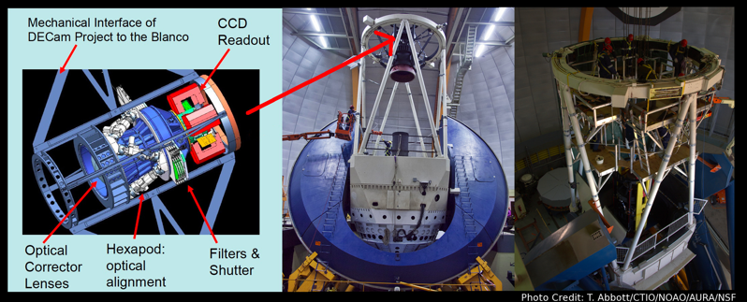
DECam
The DES Camera: the most powerful digital space camera on Earth. Weighs around 4 tons. Built at Fermilab.

Slide 16
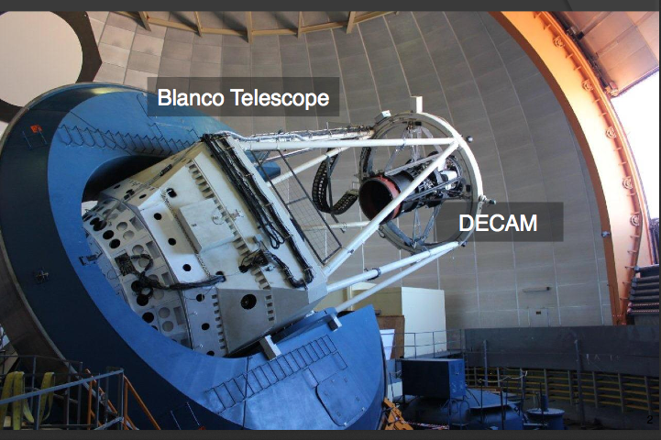
DECam
Able to see light from more than 100,000 galaxies up to 8 billion light-years away in each snapshot.

Slide 17
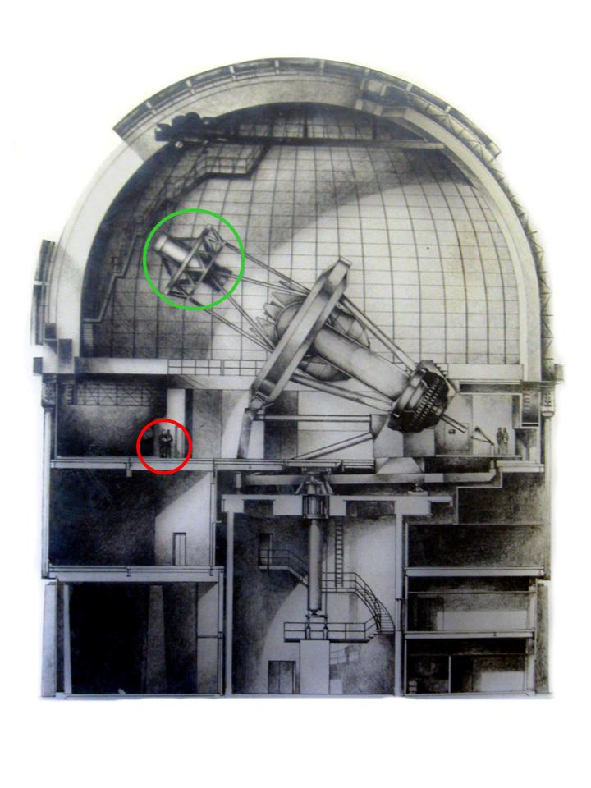
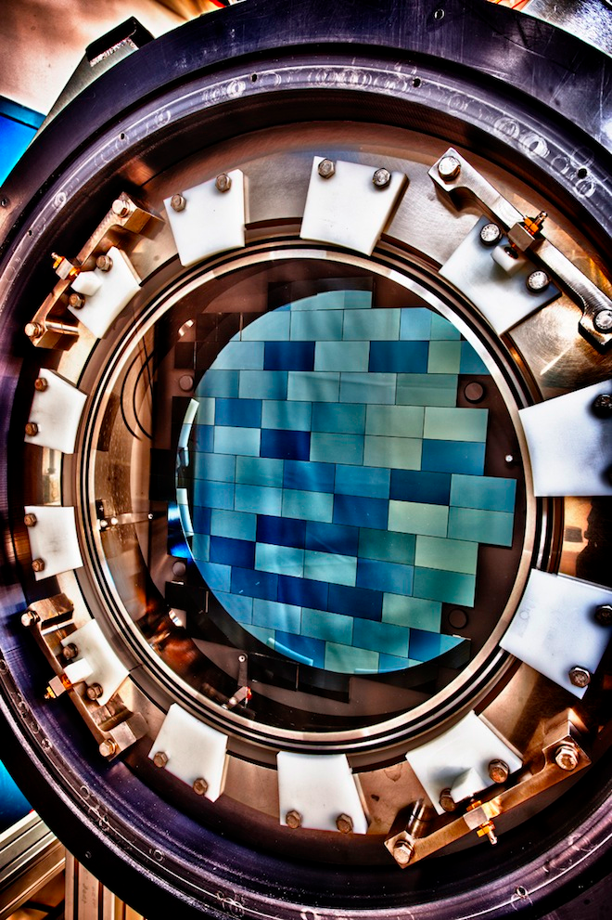
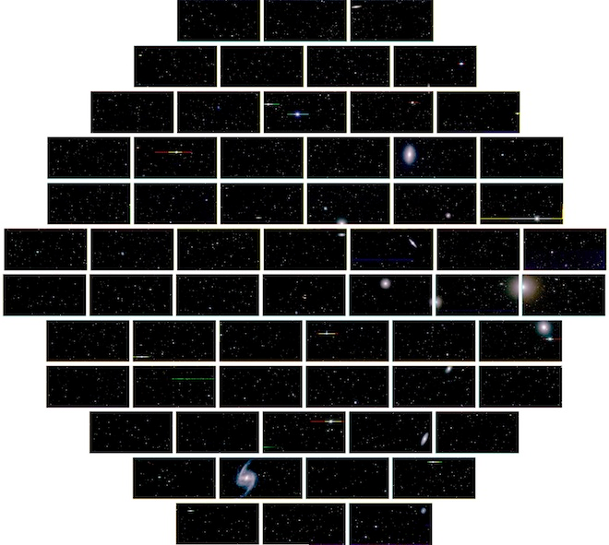
DECam
The DES Camera: 62 large CCDs – 570 megapixels.
1st light on September 12, 2012.
Fornax cluster of galaxies

Slide 18
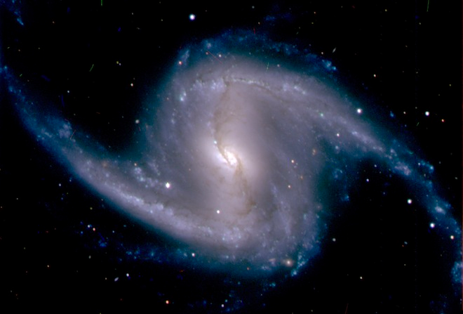
DECam
Barred spiral galaxy NGC 1365 in the Fornax cluster of galaxies

Slide 19
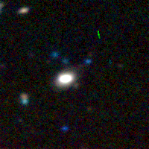
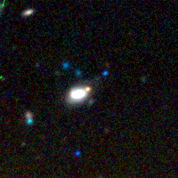
DECam
First SN confirmed by DES
Nov. 7 Dec. 15
SN Ia at z=0.2 confirmed at AAO

Slide 20
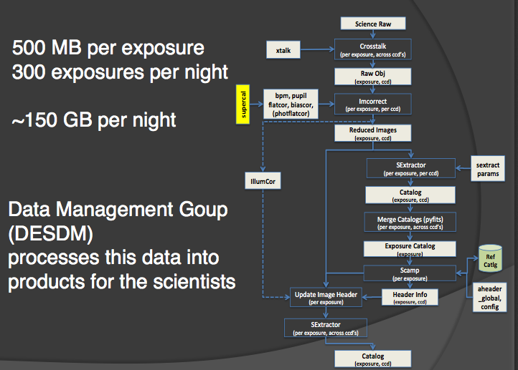
DESDM
Stefan C. Müller

Slide 21
Science Portal
The final outcome of DES will be a very large file – a catalogue of objects.
This catalogue contains the objects and their characteristics (coordinates, redshift, redshift errors, colors, etc). Very important details: star-galaxy separation, masks, photo-z algorithm, cluster-finder algorithm,

Slide 22
Science Portal
Catalogue is the basis to extract the cosmology – but must be “filtered”to contain only the relevant information – “Value Added Catalogue”.
Several DCs and a Blind Cosmology Challenges
Needs an environment to host pipelines that extract the cosmology from catalogues.
Brazilian contribution: Science Portal – a computational environment for doing science.

Slide 23
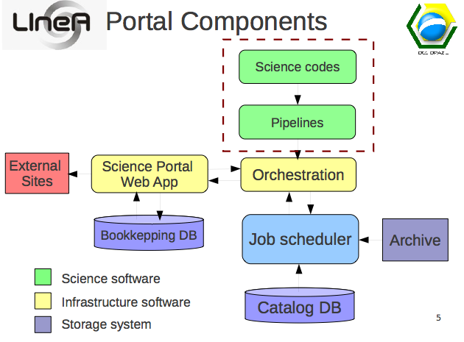
Science Portal
Angelo Fausti

Slide 24
Science Portal
Ricardo Ogando

Slide 25
Blind cosmological challenge
The BCC-Aardvark-v1.0 catalog released on April 11, 2013.
It is a 10313 deg2 (one quarter of the sky) catalog to DES full depth. A mask for the 5000 deg2 DES footprint was also provided.
Semi-blind cosmology challenge: simulates a flat ΛCDM cosmological model.
All other parameters are unknown.
The catalog contains 1.36 billion galaxies passing the DES 5-sigma signal-to-noise limit in at least one DES band.
The observed catalogs with DES grizY magnitudes and errors comprise 175 GB of data and were downloaded from SLAC at approximately 150 Mbps in about 2.5 hours.

Slide 26
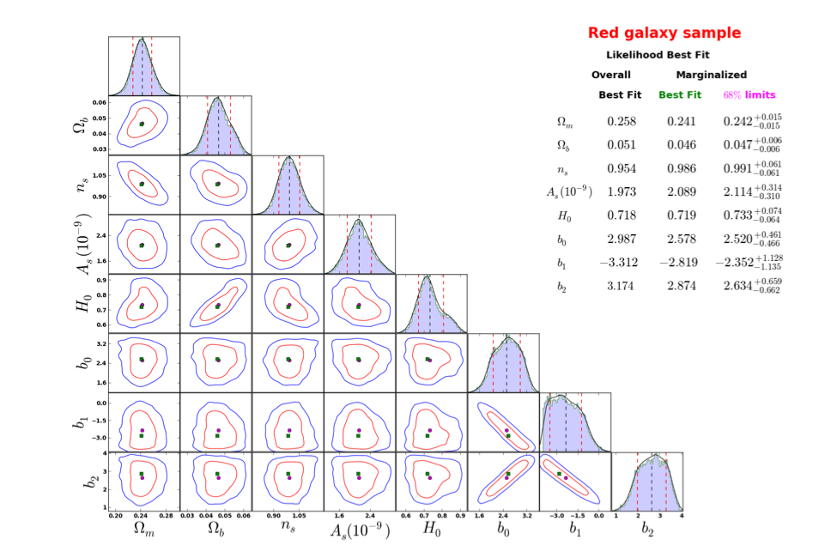
Blind cosmological challenge
DES-Brazil team 2013

Slide 27
Summary
Dark Energy Survey: uses 4 complementary techniques to extract cosmology – LSS, Clusters, SN, Lensing – challenge to combine these probes!
1st light on September 12 2012; official start of science data on August 31st 2013.
Science pipelines being tested on simulations - BCC
Analysis of the Science Verification Data is ongoing
Looking forward to having science data!

Slide 28
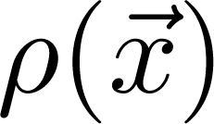
Large Scale Structure
From the large file estimate a density field that can describe the galaxy distribution in the survey:
Fluctuations can be described by a density contrast:

Slide 29
Large Scale Structure
Fluctuations are a random gaussian field: characterized
by its moments – 1pt (average), 2pt (variance), 3pt, ...
Two-point spatial correlation function
...
Homogeneity and isotropy
random

Slide 30
Large Scale Structure
Interpretation of 2 pt. correlation function: excess
(or deficit) of clustering over random at a given scale r
random
random

Slide 31
Large Scale Structure
One can define a power spectrum:
It’s possible to work with either spatial correlation
function or power spectrum – adv. and disadv.
Sharp peak in correlation results in oscillations in the
power spectrum
random

Slide 32
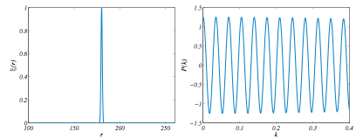
Large Scale Structure
random

