Slide 1

Measurements and theory of
neutron stars masses
J.E. Horvath,
IAG – USP
São Paulo, Brazil
with O. Benvenuto & M.A. De Vito (La Plata)

Slide 2
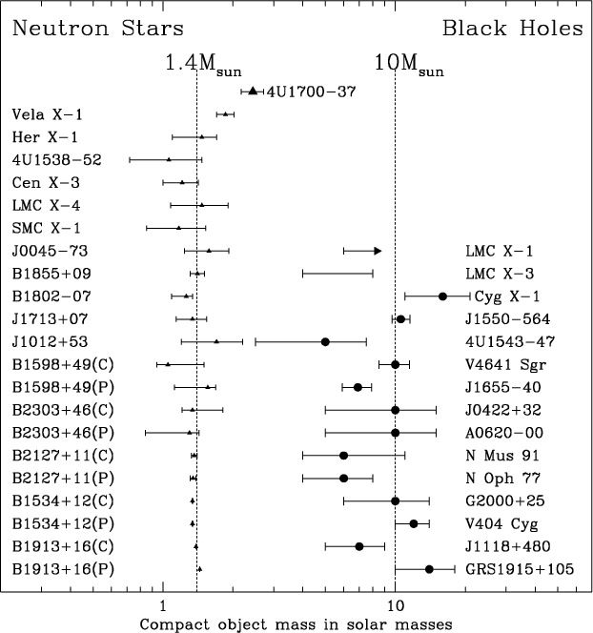
Once upon a time the idea of a single mass scale was
firmly rooted in the community
Figure from
Clark et al.
A&A 392, 909 (2002)
Consistent with 1.4 M

Slide 3
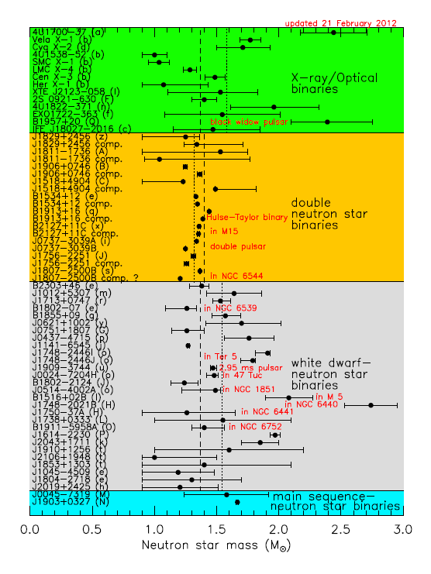
However, the newest
evidence points towards
a much wider range
of masses
Sample compiled by
Lattimer et al 2012,
available at
http://www.stellarcollapse.org/nsmasses

Slide 4
Bayesian analysis (Valentim, Rangel & Horvath, MNRAS 414,
1427, 2011) points out that one mass scale is unlikely, the
distribution is more complex. Within a double gaussian scenario,
two masses are present : 1.37 and 1.73 M_{O} (by the way, exactly what
Woosley & collab. predicted long time ago...)
Is the high value related to the size of the Fe core? (jump @ 18 M_{O})
Are some of them born as such, massive ?
Accretion role important? Stay tuned...
Other works finding the same pattern:
Zhang et al. A&A 527, A83, 2011
Özel et al., ApJ 757, 55, 2012 (1.33 and 1.48 M_{O})
Kiziltan, Kottas & Thorsett, 2013 (1.35 and 1.55 M_{O})

Slide 5
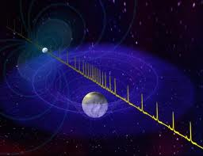
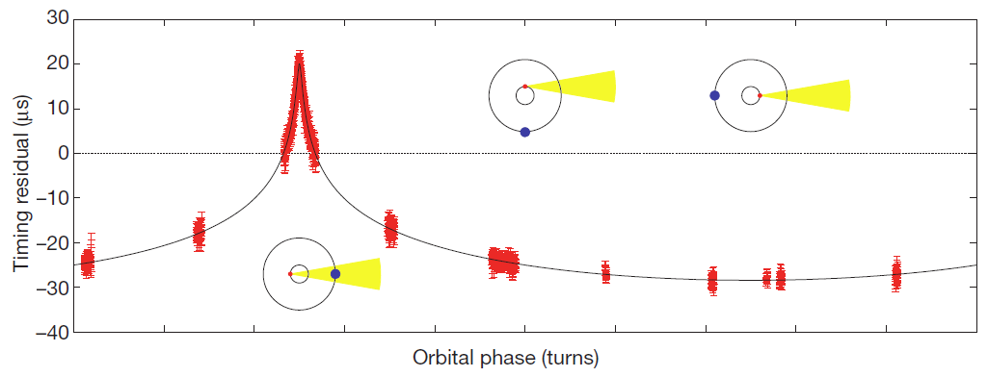
Demorest et al 2010: a NS with M~ 2 M_{O} measuring the Shapiro delay
“clean” measurement
widely accepted

Slide 6

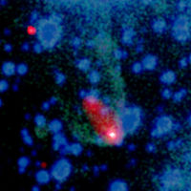
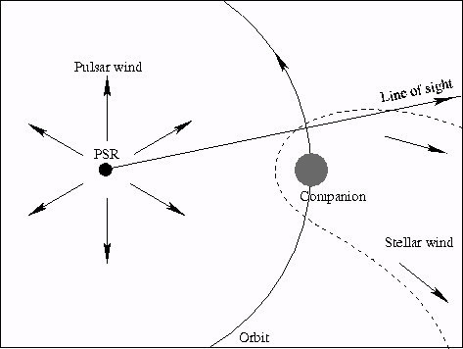
1982: Backer et al. discovered the first member of the ms
pulsar class RECYCLED BY ACCRETION?
1988: Fruchter, Stinebring & Taylor (Nature 333, 237, 1988) found an eclipsing pulsar with a very low mass companion, the hypothesis of ablation wind quickly follows
Original sketch of the PSR 1957+20 system
Composite Image from Chandra (2012)

Slide 7
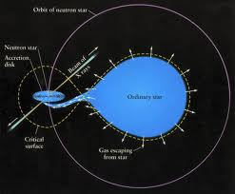
“Black widow” pulsars
Relatives of the accreting X-ray binaries…
LMXRB
and others
Many ms
pulsars in
binaries

Slide 8
M. Roberts, arXiv:1210.6903

Slide 9
Last members of the zoo:
PSR J1719-1438 (Bailes et al., Science 333, 1717, 2011)
Extremely low mass companion, yet high mean density
ρ > 23 g cm⁻³ for it
PSR J1311-3430 (Romani et al. , ApJ 760, L36, 2012)
similar system, but with extremely low hydrogen
abundance for the donor n_{H} < 10⁻⁵

Slide 10



How are these ultra-compact systems formed?
(Benvenuto, De Vito & Horvath ApJL 753, L33, 2012)
primary (NS) ; secondary (donor)
Onset of Roche Lobe Overflow (RLOF) , Paczynski
Accreted by the NS,
always<

Slide 11


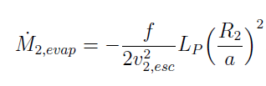


In general, and angular momentum is lost
from the system. The exact value of is not critical
1st ingredient
(Ritter, A&A 202, 93, 1988)
Evaporating wind
2nd ingredient
(Stevens et al., MNRAS 254, 19, 1992 )
with
Irradiation feedback
3rd ingredient
(Bunning & Ritter, A&A 423, 281, 2004
Hameury)

Slide 13




All three effects incorporated into an adaptative Henyey
code, solving simultaneously structure and orbital evolution
(Benvenuto & De Vito, 2003 ; De Vito & Benvenuto, 2012)
must be in the “right” range to explain the
observed systems
If is too short (< 0.5 d), the mass transfer would start at ZAMS
If is too long (> 0.9 d), the orbit widens and a ~0.3 Mo
not the observed state !
If is too small, mass transfer would be > age universe
If is too high, mass transfer is unstable (Podsiadlowski et al)
Started calculations right after the NS formation
CAVEAT !!!, just an hypothesis

Slide 14
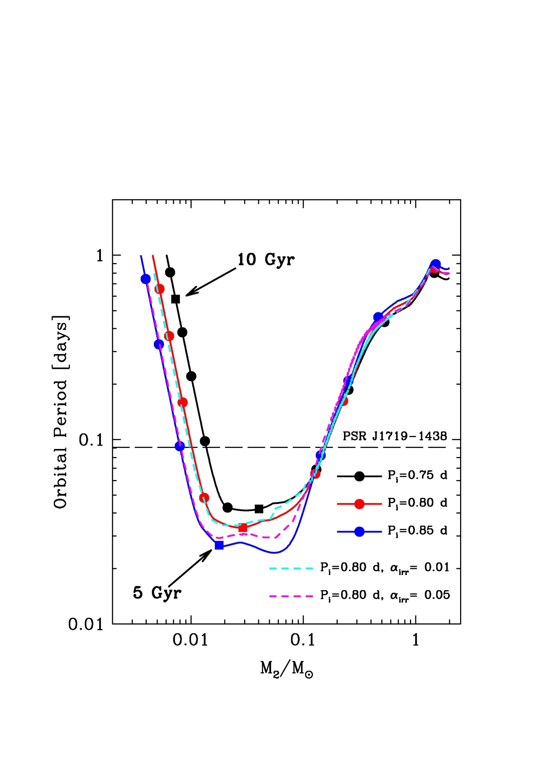
At slightly larger initial
periods, the secondary
detaches at high mass
and do not produce
“black widow” systems
PSR J1719-1438
Low –inclination
solutions acceptable

Slide 15
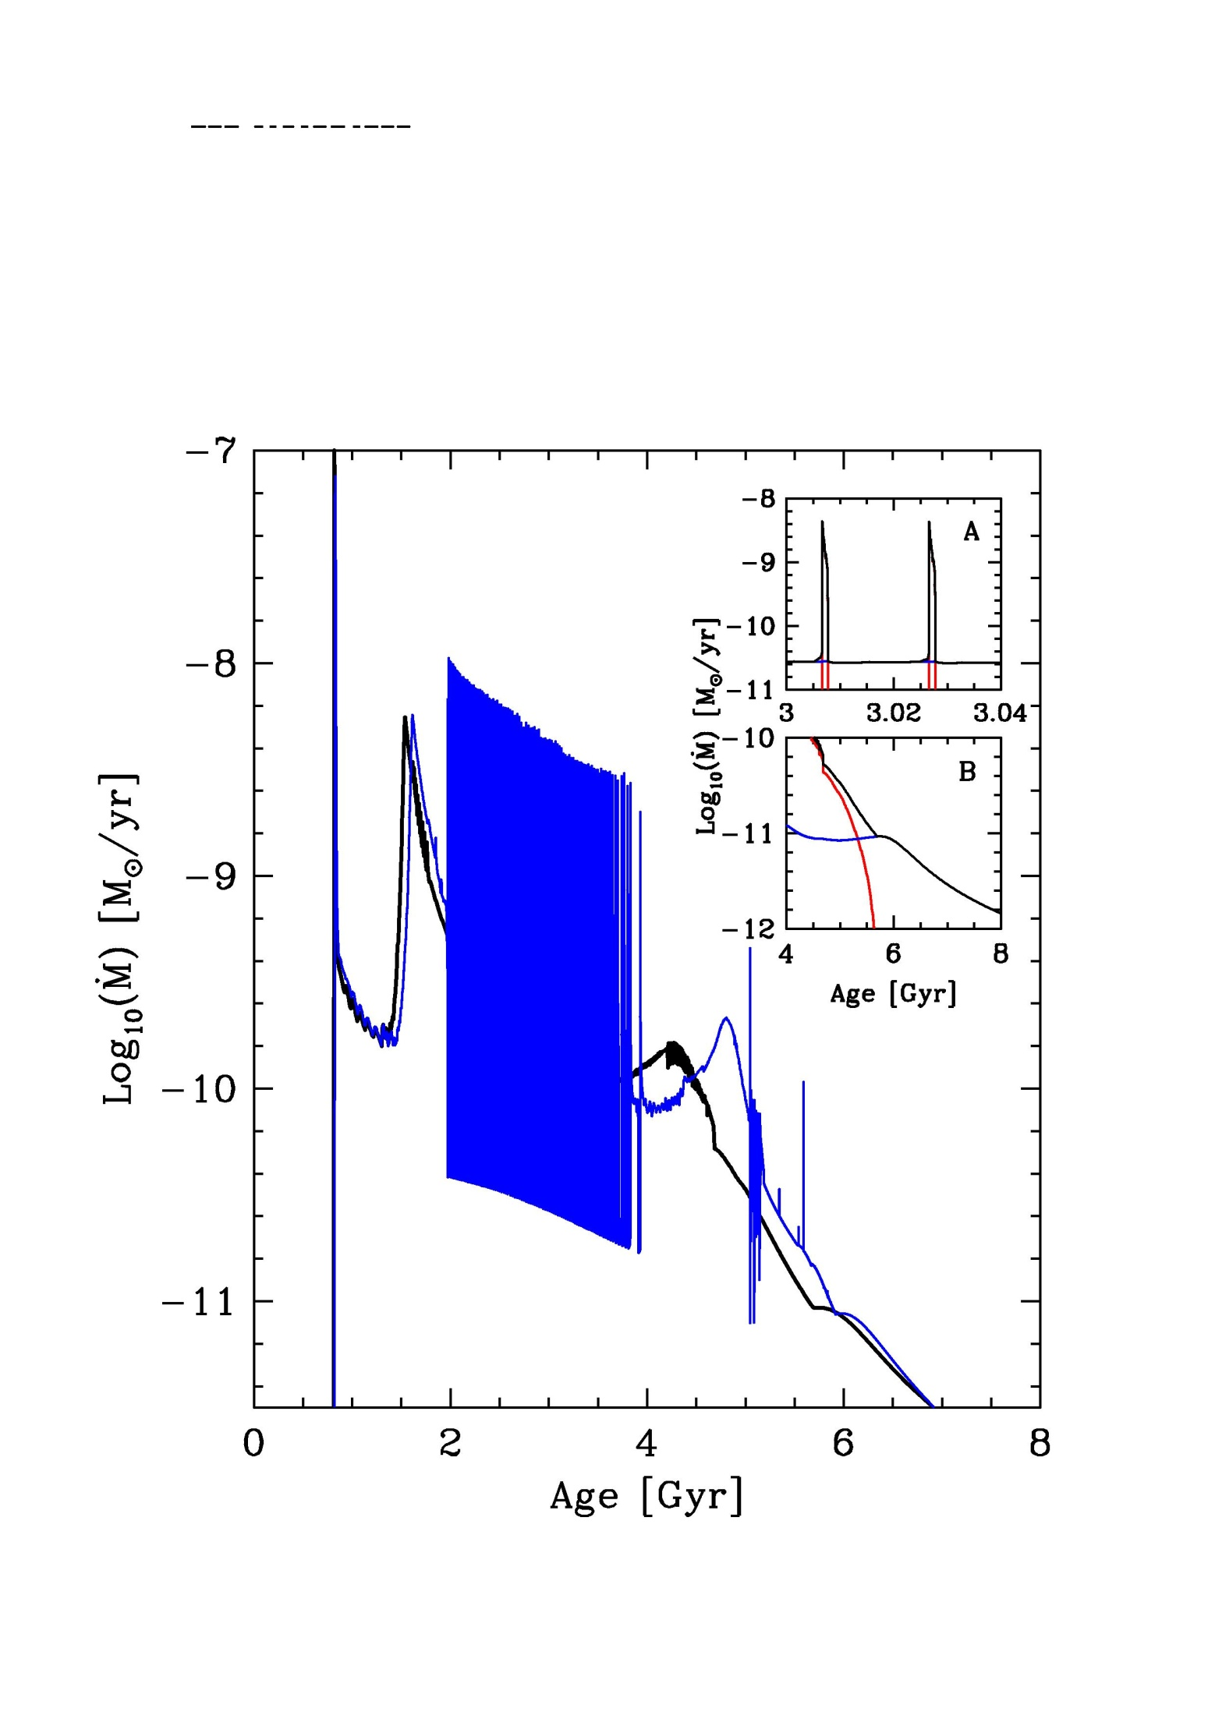
PSR J1719-1438
The system goes
back and forth
from accretion to
isolation at
intermediate mass
Not a numerical
instability

Slide 16
The original “black widow” PSR 1957+20: new results
(van Kerkwijk, Breton & Kulkarni, ApJ 728, 95, 2011)
Mpsr/M₂ ~ 70 (through spectral lines, radial velocity)
M_{psr} = 2.4 +- 0.12 M_{O}
(M_{psr} > 1.66 M_{O} firm)
Romani et al. (ApJ 760, L36, 2012) found three high values
for the neutron star in PSR J1311-3430, depending on the
interpretation M_{psr}> 2.1 M_{O} up to ~ 3 M_{O}

Slide 17
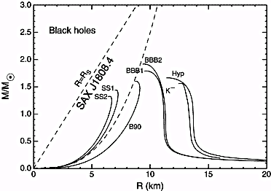

Slide 19
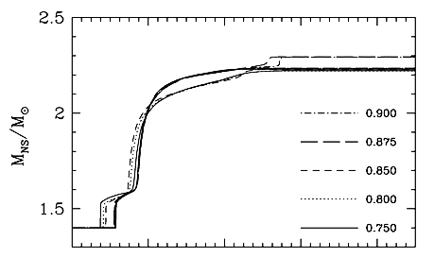
Self-consistent calculations of the PSR J1311-3430 system
require such high values to reach the observed state
Calculations for several values of the initial period,
and fixed accretion efficiency β of 50%

Slide 20
Conclusions
* Ultra-compact “black widow” pulsar systems result
from a bifurcation in parameter space, in this
sense they are a new evolutionary path. Hydrogen-free
companions result from very tight initial conditions
*
*
* The role of winds+irradiation is crucial : RLOF alone
would not produce anything like PSR J1719-1438 or
PSR J1311-3430 The full parameter space needs exploration,
but we can state that PSR masses emerging are consistently
very large
* For the original black widow,just the radius comes out
Wrong by factos ~2-3, but the opacities were extrapolated
and it should not be a surprise, meanwhile period,
mass ratio, OK
*

