Slide 1
Concluding Remarks
to the 6th IWARA
J.E. Horvath,
IAG – USP
São Paulo, Brazil

Slide 2
Olinto: colorful panorama of (non-accelerator)
high-energy physics/astrophysics
10⁶ x higher than a TeV scale (Higgs) !!
R. Negreiros: discussion non-spherical effects
(Cas A?) general scope
G. Contrera: beyond simple models , non-local NJL
confines, yet mean field solution developed
C. Vasconcellos: “genuine” vs. “effective” 3 body
forces. Mean field solution again !!!

Slide 3
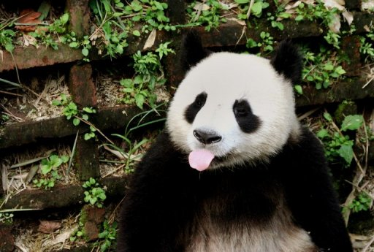
H. Stocker: a FAIR opportunity for extreme matter physics!
FLAIR (antimatter)
CMB, PANDA, NuStar → neutron star physics
Vacuum instability probed

Slide 4
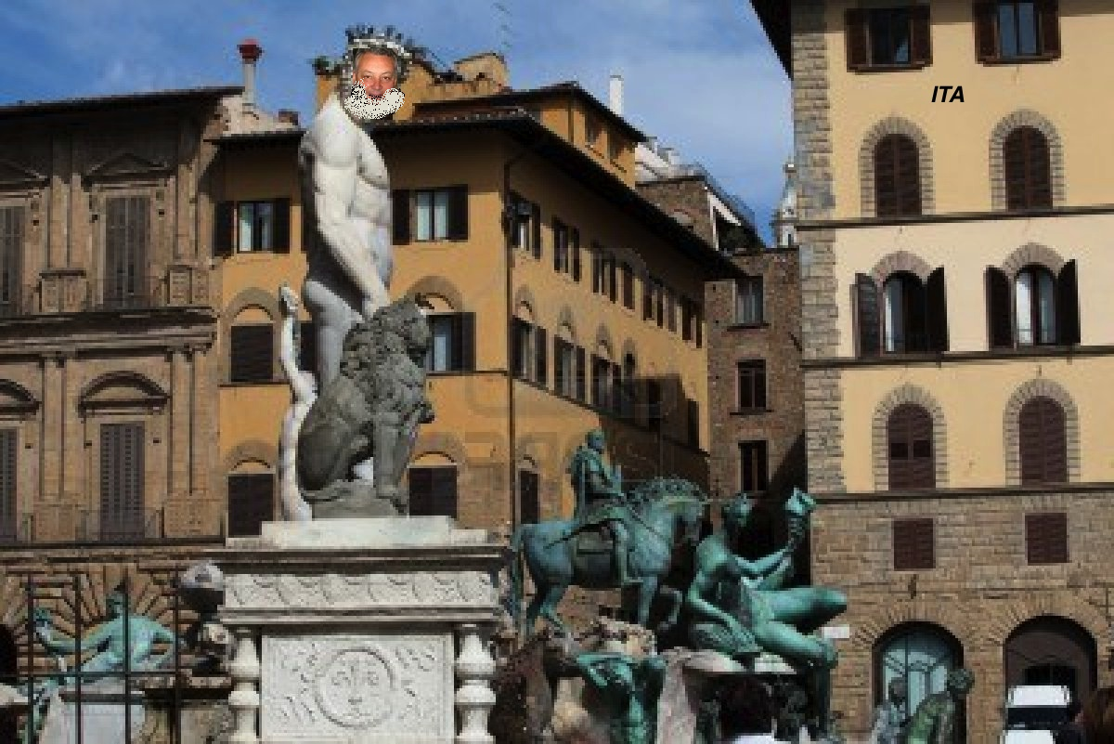
M. Malheiro: it is not easy to violate virial relations,
no massive white dwarfs (B² blows them away!)
The Golden Age of ITA

Slide 5
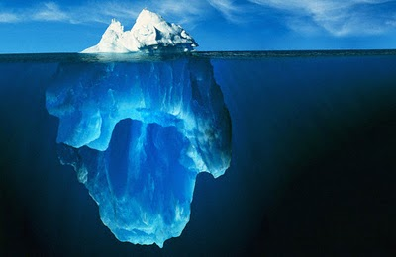
M. Alford: deep into the physical reasons of QCD
pairing and its effects in NS
Surface effects drive ‘crusts” in SS
However… a few quark system sits probably in shell
states, hence “strangelets” could be structured, not
just “drops”
S. Schramm: SU(3) grounded approach + excluded
volume+ non-linear extra repulsion
D. Manreza Parets: giving up spherical symmetry
prolate “stars” (cuban cigars?), still
problems with metric matching & EoS

Slide 6
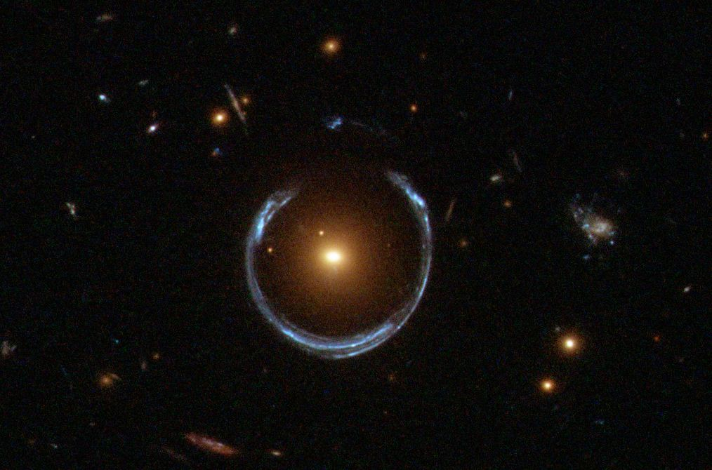
M. de Avellar: entropy as a tool to investigate composition
H. Montoya: strong lensing reconstruction of mass
distributions, cute but difficult
M.E. Pereira: CFHT/MegaCam
Stripe 82 Survey
Galaxy morphology

Slide 7
S. Perez Bergliaffa: relativistic Bondi-Hoyle accretion
easier handling, still quite ideal
L. Pellizza: the devilish details of supposedly known
physics → our Universe in a simulation
The concept of INFINITELY WRONG things
D. Rodrigues: quantum effects at large scales
G(μ) running constant, DM still
needed

Slide 8
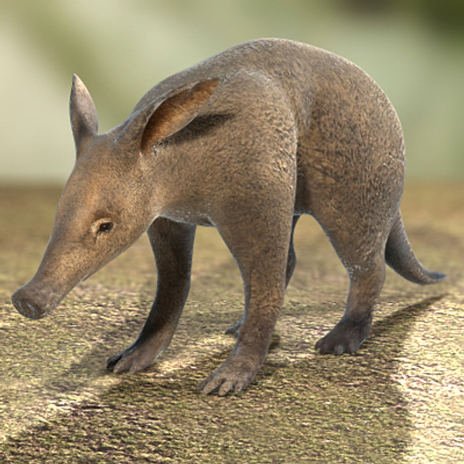
M.E. Guimaraes/Xico: what is the true nature of Hawking
radiation?
M. Dvornikov: neutrinos in a gravitational field, explicit
calculation of oscillations
M. Reintjes: dealing with discontinuities in GR
New observables? (distortion of GW?)
R. Rosenfeld (a Very High Frequency guy):
DES (dark energy + spinoffs)
A. Perez Martinez: anomalous MM
V. Pagura: more on non-local PNJL
comparison with lattice

Slide 9
Highlights
* A truly dedicated organization, pro level
* The quality of most poster presentations, highly
rated by the organizers
So long IWARA !!!

