Slide 1
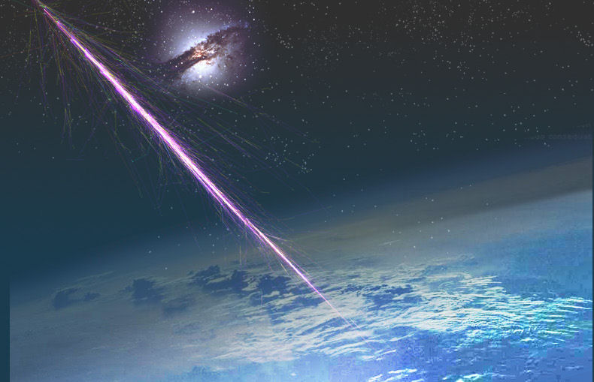
Where do UHECRs
come from?
Angela V. Olinto
The University of Chicago

Slide 2

Where do UHECRs
come from?

Slide 3
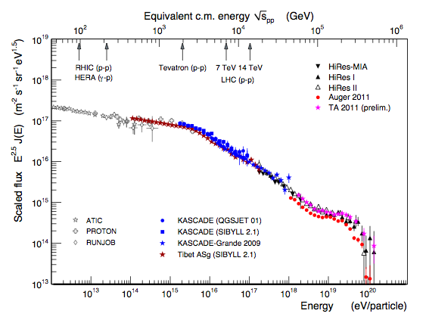
knee
ankle

Slide 4
knee
Ultrahigh Energy
Cosmic Rays
E > 10¹⁸ eV
= 1 EeV
ankle

Slide 5
knee
Ultrahigh Energy
Cosmic Rays
E > 10¹⁸ eV
= 1 EeV
ankle
Extragalactic

Slide 6
“Known unknown”
Cosmic Magnetic Fields
R_{L} = kpc Z⁻¹ (E / EeV) (B / μG)⁻¹
R_{L} = Mpc Z⁻¹ (E / EeV) (B / nG)⁻¹
1 EeV = 10¹⁸ eV
γ
Extra-galactic B?
B < nG
weak deflection
E > 10¹⁹eV
Galactic B deflection
<< 10º Z (40 EeV/E)
anisotropic in sky
Halo B?
strong deflection
E < 10¹⁸eV
Milky way
B ~ μG
kpc
10 kpc

Slide 7
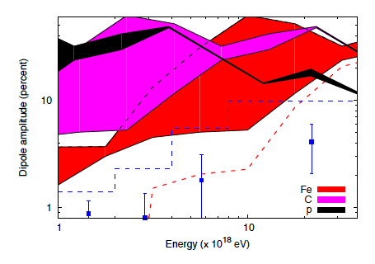
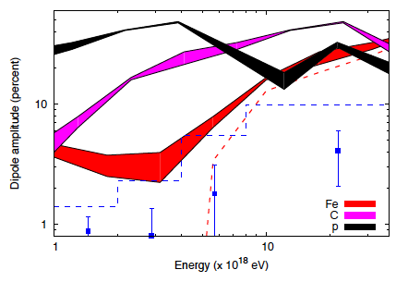
Galactic Plane Anisotropy
E>20 EeV Cosmic Rays are EXTRAGALACTIC
Auger Anisotropy limits: rule out Galactic protons to CNO as dominant CR component E > 1 EeV and Fe above 20 EeV
Giacinti et al ‘11
6

Slide 8
knee
ankle

Slide 9
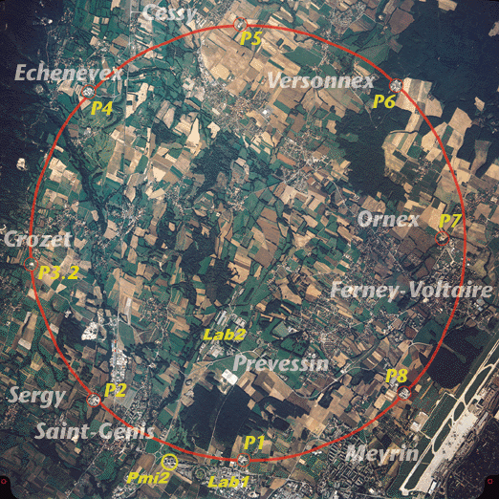
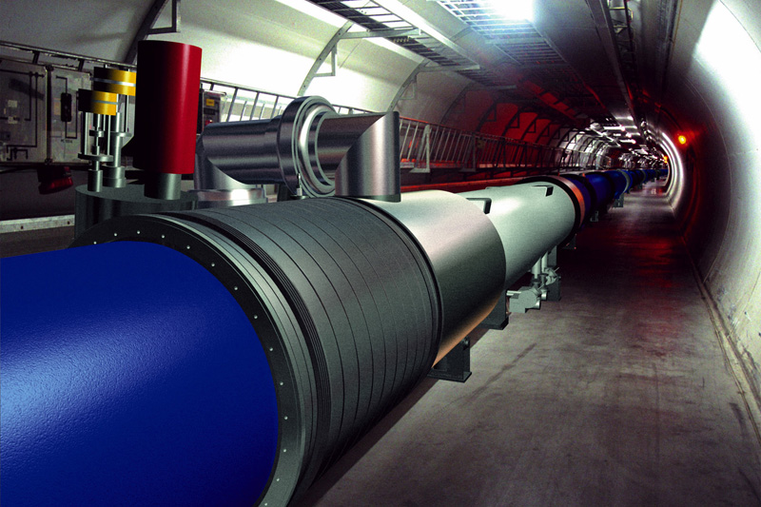
Challenging Accelerators
to reach 10²⁰ eV
LHC magnetic field,
radius ~ 10⁷ km (Sun - Mercury)
or 10 GT fields!
Notes:
LHC = 8.36 Tesla = 8.4 10^4 G
G = 10^-4 T

Slide 10
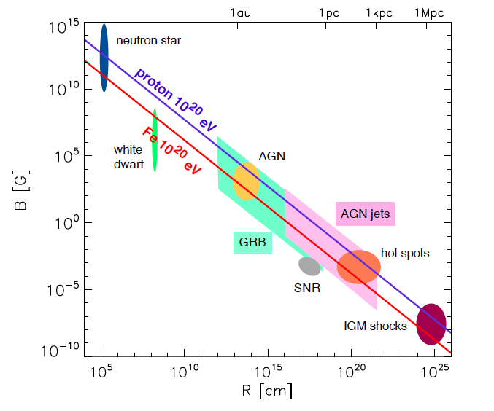
Hillas Plot: E_{max} required
R_{L} < R_{source}
B/μG > (E_{max}/ Z EeV) (1.1kpc/R_{source})
LHC
LHC
white
dwarf
white
dwarf
Kotera & AO‘11
Notes:
Easier for Iron
LHC = 8.36 Tesla = 8.4 10^4 G, 27 km = 2.7 10^6 cm
G = 10^-4 T

Slide 11
Hillas Plot: E_{max} required
proton acceleration harder, but much more abundant
LHC
LHC
white
dwarf
white
dwarf
Iron easier to accelerate, but harder to find in ISM
+ easily destroyed
Kotera & AO‘11
Notes:
Easier for Iron
LHC = 8.36 Tesla = 8.4 10^4 G, 27 km = 2.7 10^6 cm
G = 10^-4 T

Slide 12
Hillas Plot: E_{max} required
accelerator efficiency
β <<1,
relativistic effects –
modify R to R/Γ
time dependent transients
LHC
LHC
white
dwarf
white
dwarf
Kotera & AO‘11
Notes:
Easier for Iron
LHC = 8.36 Tesla = 8.4 10^4 G, 27 km = 2.7 10^6 cm
G = 10^-4 T

Slide 13
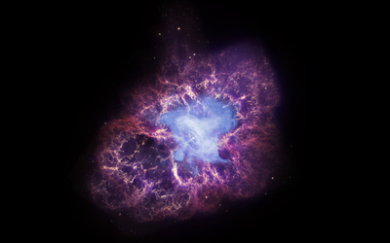
Neutron Stars

Slide 14
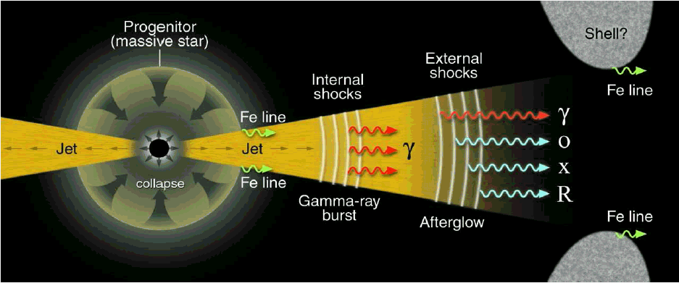
Gamma-ray Bursts
Meszaros ‘01

Slide 15
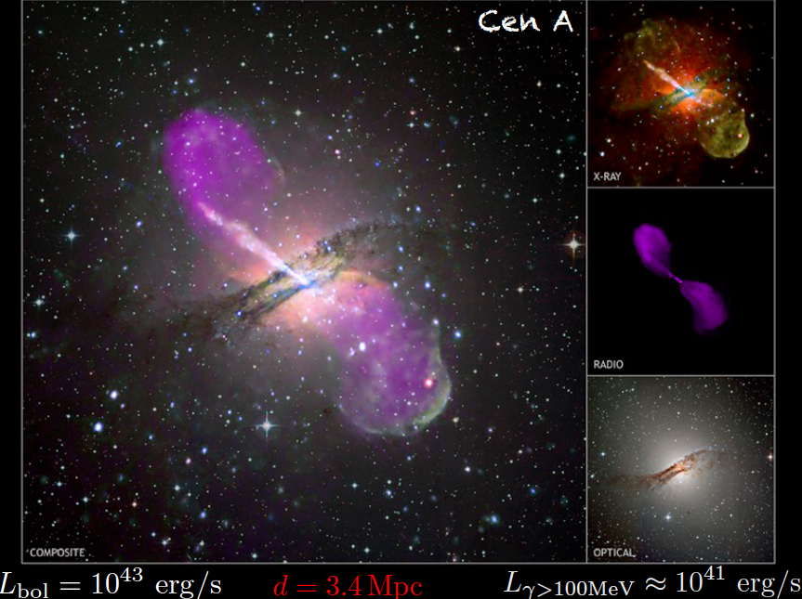

Slide 16
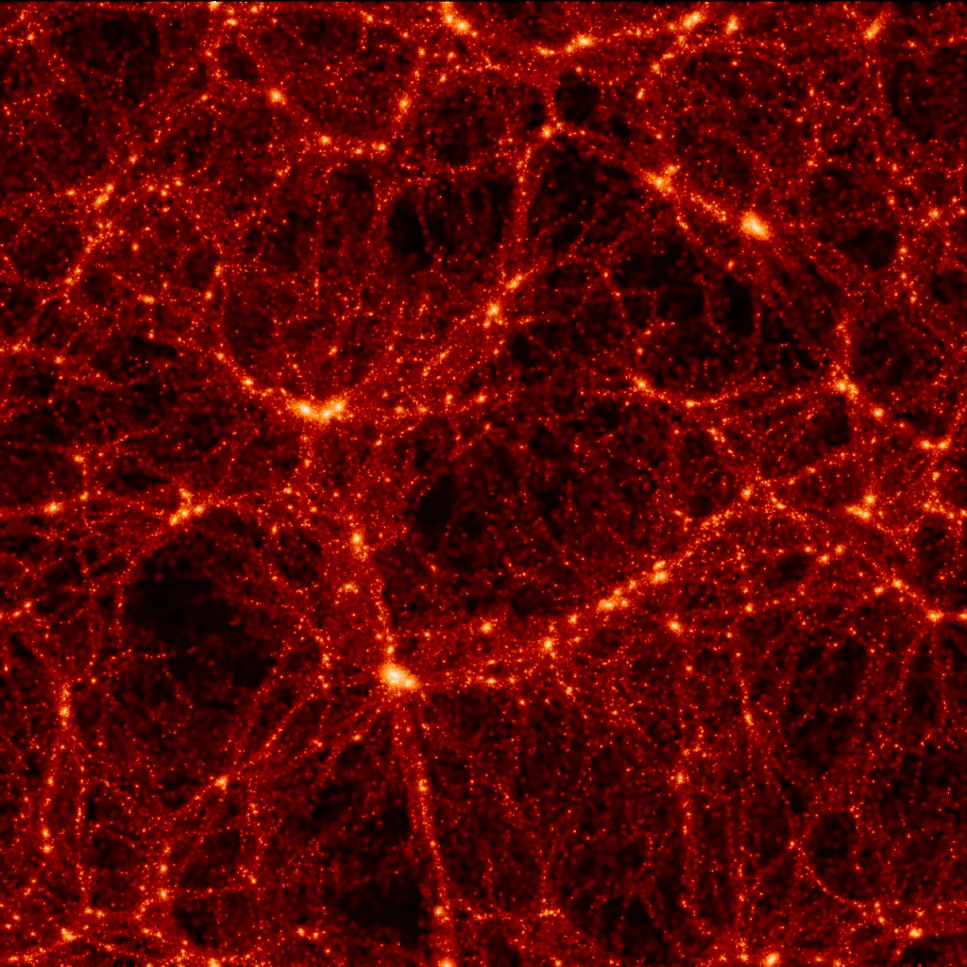
Inter Galactic Medium
Accretion Shocks
but Vannoni et al. (2009) says E_{max} < few 10¹⁹ eV

Slide 17
Sources of UHECRs?
Extragalactic E > 10¹⁸ eV
Transition from Galactic to Extragalactic is ill constrained.
E_{max} hard to reach: GRBs, AGN, Young NSs, ?
Diffusive Shock Acceleration (DSA) fits well Galactic Cosmic Rays: power-law spectrum ~ E^{-2.x}

Slide 18


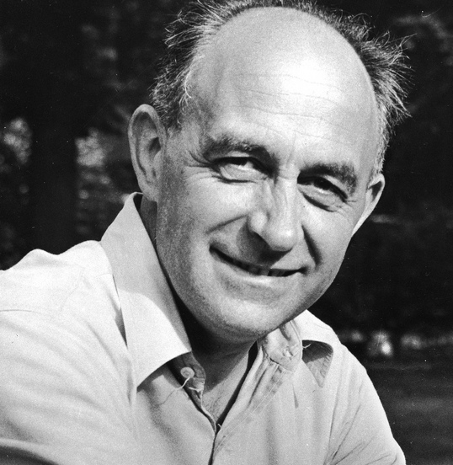
GRBs & AGN models mostly based on
Shock Acceleration
2nd order
1st order Fermi
Fermi 1949
Axford et al. 1977; Bell 1978;
Blandford & Ostriker 1978; ...

Slide 19
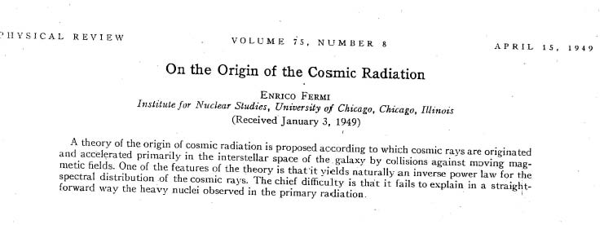

Slide 20
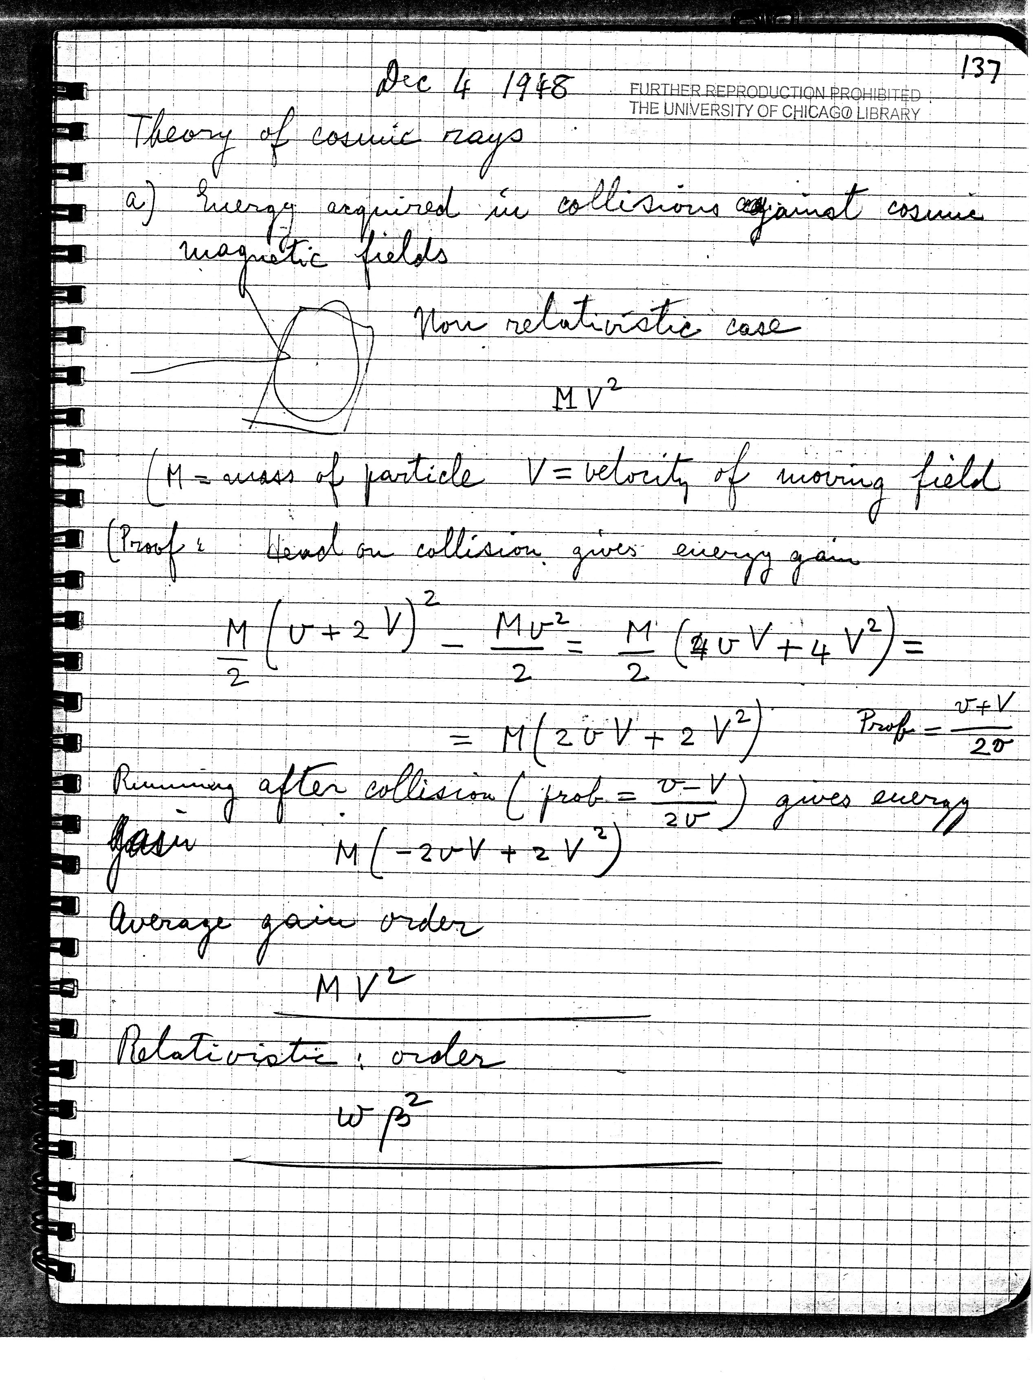

Slide 21








Fermi: Magnetized Clouds
Transfer of Macroscopic Kinetic Energy to Microscopic Particles
Relativistic Particles
Non relativistic clouds β_{cl} <<1
1D version
Frame of cloud
E₁
E₀
~

Slide 22
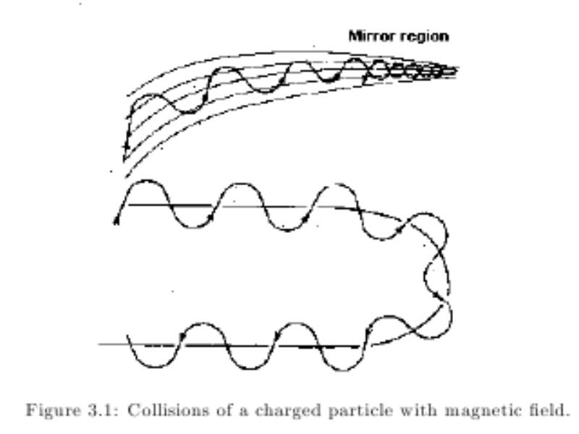
Fermi: Magnetized Clouds
Transfer of Macroscopic Kinetic Energy to Microscopic Particles
Relativistic Particles
Non relativistic clouds β_{cl} <<1
1D version
Frame of cloud
E₁
E₀
~
Why turn around?
Magnetic Mirrors

Slide 23
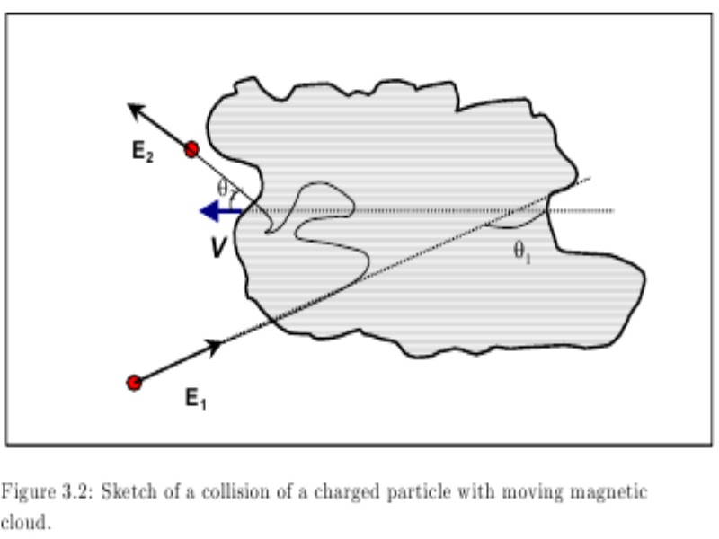





Fermi: Magnetized Clouds
Relativistic Particles
1D version
Frame of cloud
E₁
E₀
~
In 2 D can gain or lose energy
E₁ = γ² E₀ (1-βcosθ₁) (1+βcosθ₂’)
-1+ (1- βcosθ₁+βcosθ₂’-β²cosθ₁cosθ₂’)/1-β²
second order in β_{cl}

Slide 24
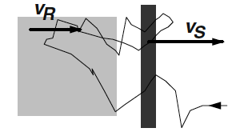
First Order Fermi: shock acceleration
-1+ (1+4β/3+4β²/9) /1-β²
≈ 4β/3
β_{shock}
β_{shock}
success for Galactic Cosmic Ray
acceleration in Supernova Remnants
Sedov-Taylor phase

Slide 25



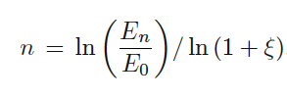







Power Law Spectrum
independent of energy ( or )
After n cycles (encounters)
P_{esc} probability of escape in each cycle
Number of particles that reach E >E_{n} :
Shock Acceleration
+ O(M⁻²)
~ E ^{– (2 + O(1/M^2))}

Slide 26
Power Law Spectrum
independent of energy ( or )
After n cycles (encounters)
P_{esc} probability of escape in each cycle
Number of particles that reach E >E_{n} :
Shock Acceleration
Success!!
+ O(M⁻²)
~ E ^{– (2 + O(1/M^2))}

Slide 27
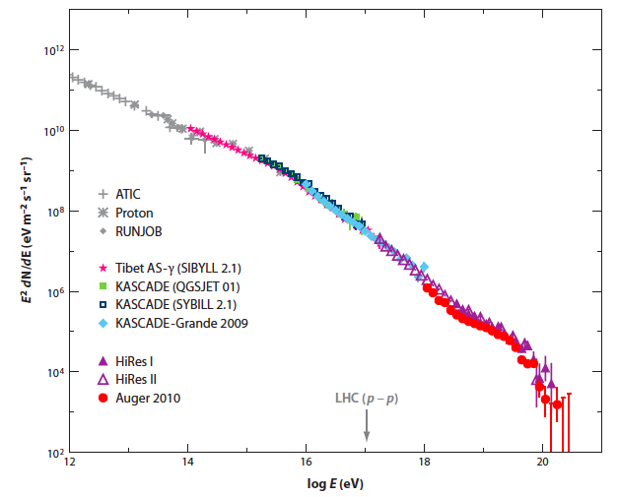
Cosmic Ray Flux x E²
E^{-2.7} ≈ E^{-2.1} E^{-0.6}
Diffusion
Injection
knee
~ E⁻³
ankle
GZK?
Kotera, AO 2011

Slide 28
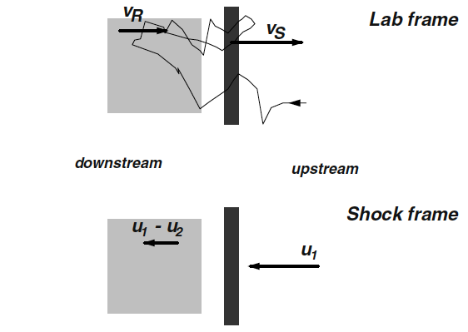
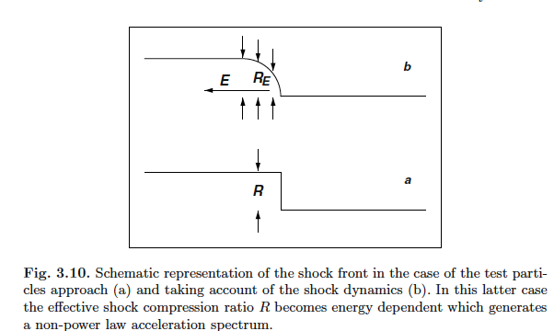
Stochastic Shock Acceleration
Non-linear effects:
backreaction of particles
on magnetic field

Slide 29
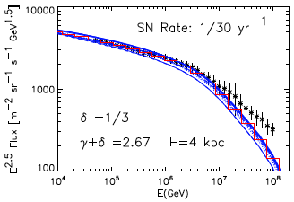
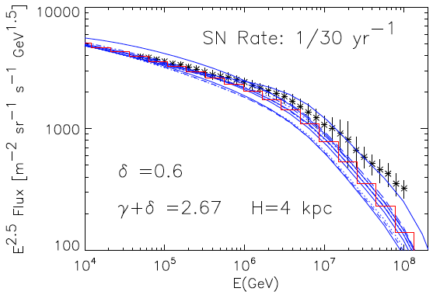
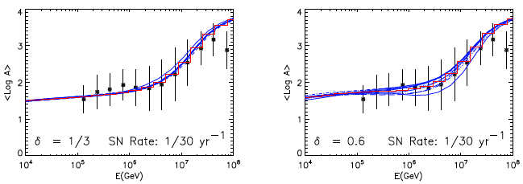
The SNR paradigm:
Acceleration + Diffusion
Blasi & Amato 2012

Slide 30
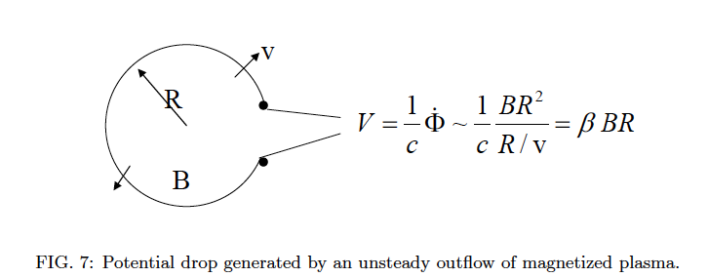

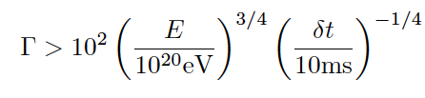
Lower bound on Luminosity
Norman et al. 1995, Waxman 1995, Lyutikov & Ouyed 2005, Waxman 2005, Lemoine Waxman 2009, see Waxman arXiv:1101.1155
Very high luminosity, Relativistic flows, transient time-scales
No known (steady) sources of 10⁴⁶ erg/s within 100 Mpc!
assuming protons

Slide 31
Sources of UHECRs?
Extragalactic E > 10¹⁸ eV
Transition from Galactic to Extragalactic is ill constrained.
E_{max} hard to reach: GRBs, AGN, Young NSs, ?
Diffusive Shock Acceleration (DSA) fits well Galactic Cosmic Rays: power-law spectrum ~ E⁻²
UHECR sources have large Luminosity
Challenges for Relativistic Shocks

Slide 32
Sources of UHECRs?
Extragalactic E > 10¹⁸ eV
Transition from Galactic to Extragalactic is ill constrained.
E_{max} hard to reach: GRBs, AGN, Young NSs, ?
Diffusive Shock Acceleration (DSA) fits well Galactic Cosmic Rays: power-law spectrum ~ E⁻²
UHECR sources have large Luminosity
Challenges for Relativistic Shocks
Alternative scenarios: unipolar inductors; wake field acceleration; relativistic shear jet acceleration, ...

Slide 33
knee
Ultrahigh Energy
Cosmic Rays
E > 10¹⁸ eV
= 1 EeV
ankle
GZK?

Slide 34
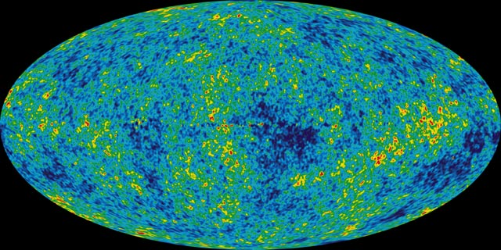
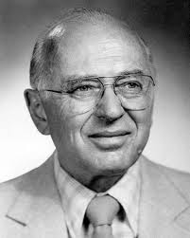
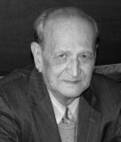
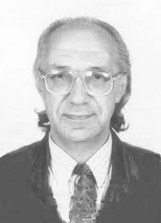
“Cosmologically Meaningful Termination”
p+γ_{cmb}→ Δ⁺ → p + π⁰
→ n + π ⁺
Proton Horizon
~5 x 10¹⁹ eV
GZK Cutoff
Greisen, Zatsepin, Kuzmin
1966

Slide 35
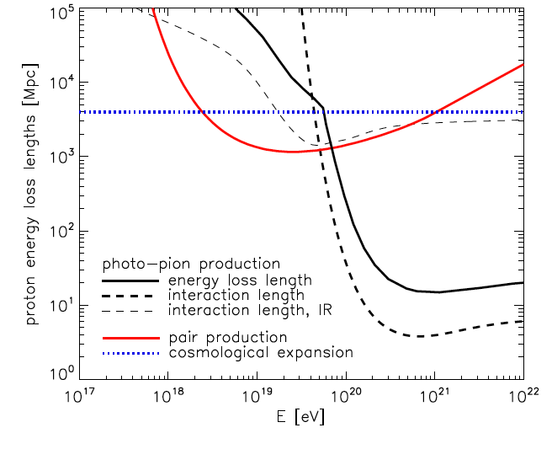
Greisen-Zatsepin-Kuzmin effect
Kotera & AO 11

Slide 36
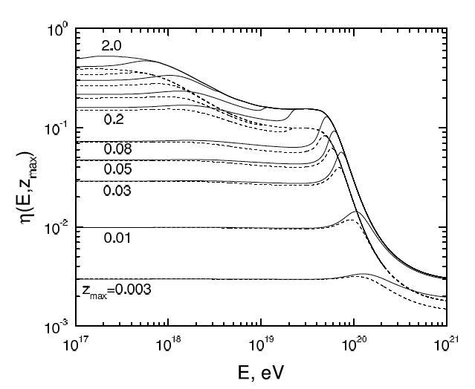
Propagation of UHE protons
Modification factor
SpectrumRecovery
Berezinsky, Gazizov, Grigoriev ‘05

Slide 37
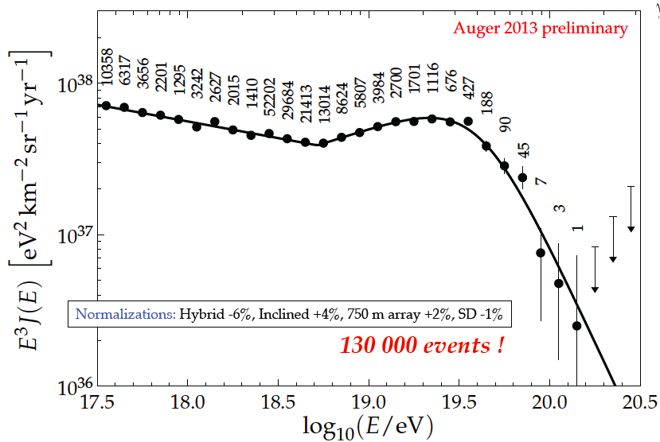
See Dembinski

Slide 38
Precision Spectrum

Slide 39
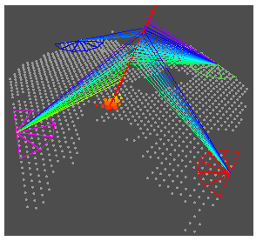
The Pierre Auger Observatory
Argentina
Australia
Brasil
Bolivia*
Croatia
Czech Rep.
France
Germany
Italy
Mexico
Netherlands
Poland
Portugal
Romania*
Slovenia
Spain
UK
USA
Vietnam*
*Associate Countries
~ 500 Scientists, 19 Countries
3,000 km² water cherenkov detectors array
4 fluorescence Telescopes
Malargue, Argentina
Notes:
19 countries, truly international

Slide 40
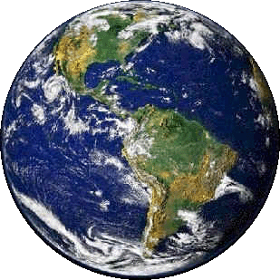
Current Observatories of
Ultrahigh Energy Cosmic Rays
Telescope Array
Utah, USA
(5 country collaboration)
700 km² array
3 fluorescence
telescopes
Pierre Auger
Observatory
Mendoza, Argentina
(19 country collaboration)
3,000 km² array
4 fluorescence telescopes

Slide 41
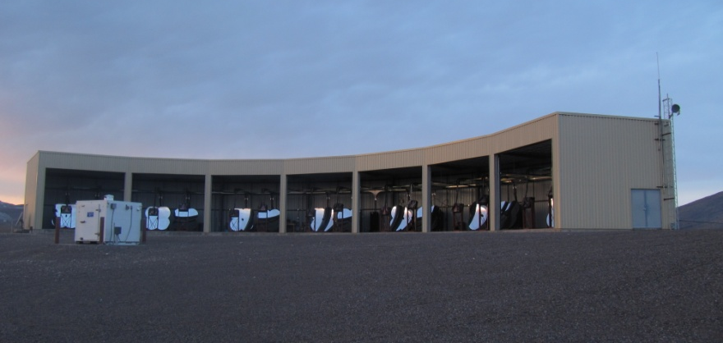
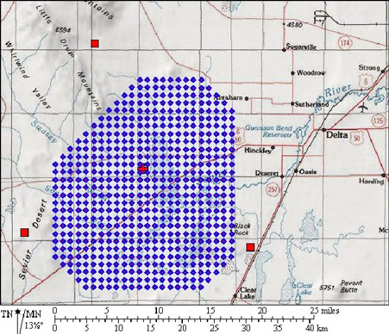
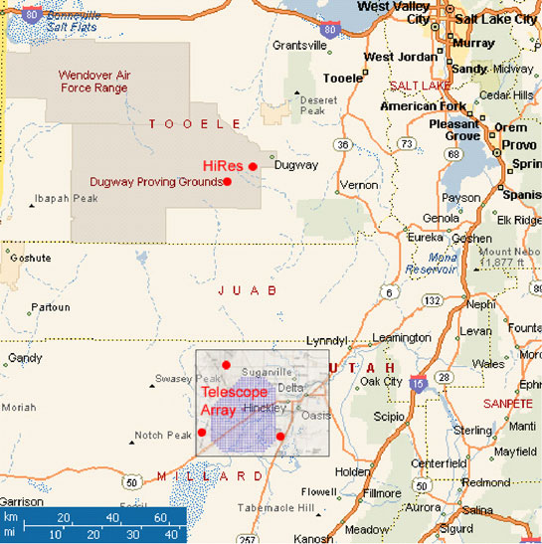
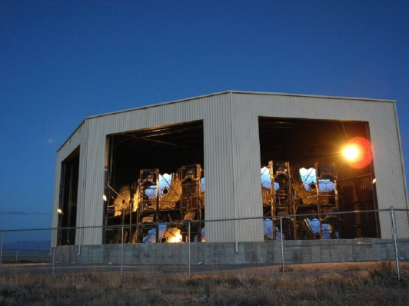
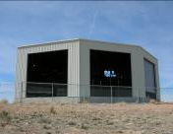
Telescope Array
Belgium
Japan
Korea
Russia
USA
Area: 700 km²
3 FD stations overlooking an array of
507 scintillator surface detectors (SD)
complete and operational as of ~1/2008.

Slide 42
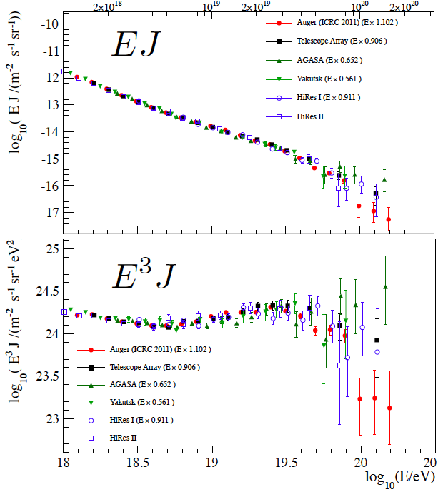
2012 CERN
Working Group
Unified Spectrum
Energies
re-scaled
Dawson et al ‘13

Slide 43
Current Status
Leading Observatories:
  Pierre Auger Observatory: 3,000 km² Argentina
  Telescope Array: 700 km² Utah, USA
Agreement on the shape of the spectrum
Energy scale: ~10% difference bet. Auger and TA

Slide 44
Current Status
Leading Observatories:
  Pierre Auger Observatory: 3,000 km² Argentina
  Telescope Array: 700 km² Utah, USA
Agreement on the shape of the spectrum
Energy scale: ~10% difference bet. Auger and TA
Composition: controversial

Slide 45
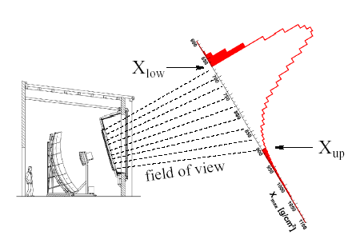
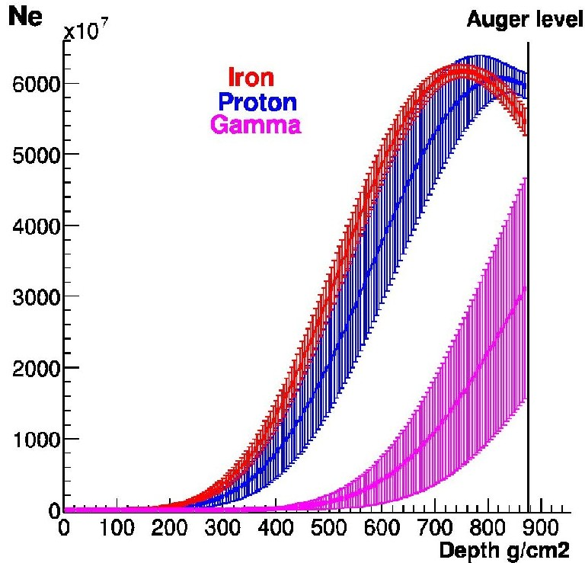
Composition observable:
shower maximum

Slide 46
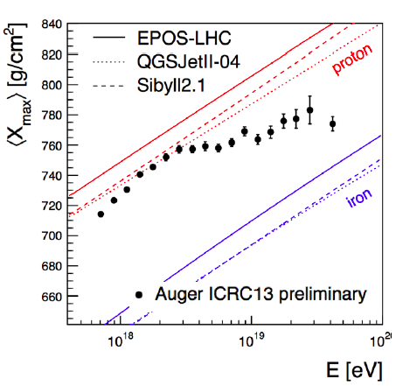
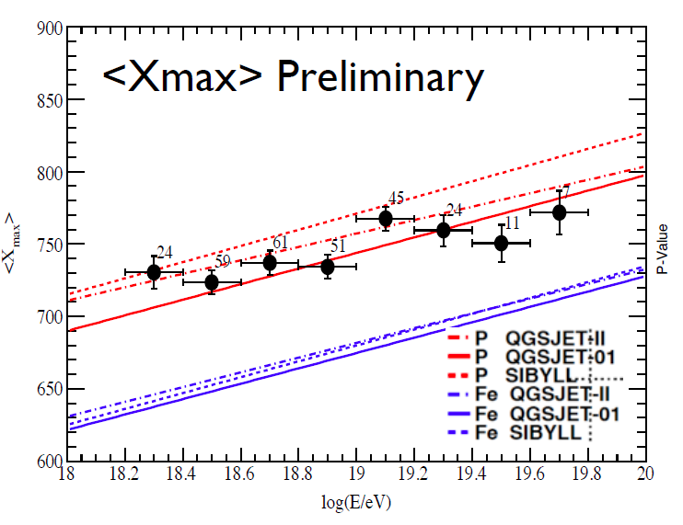
Auger
Auger sees change slope:
Change in Composition
or interactions
TA: not confirmed yet
TA
Telescope Array
Notes:
low statistics – cannot do fiducial cuts as in auger

Slide 47
Auger
Auger sees change slope:
Change in Composition
or interactions
TA: not confirmed yet
X_{max} in the atmosphere
TA
Telescope Array
X_{max} in the detector
Notes:
low statistics – cannot do fiducial cuts as in auger

Slide 48
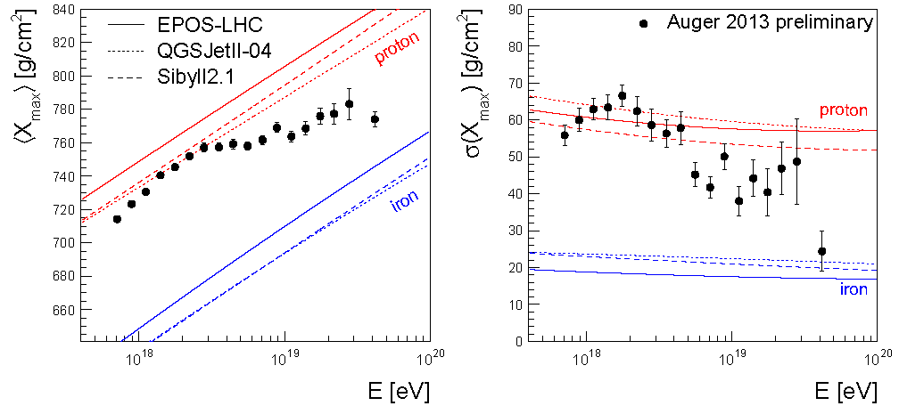
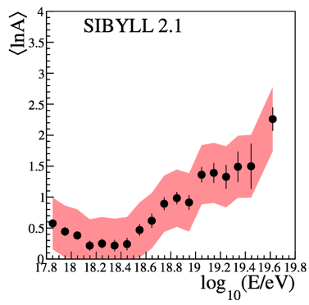
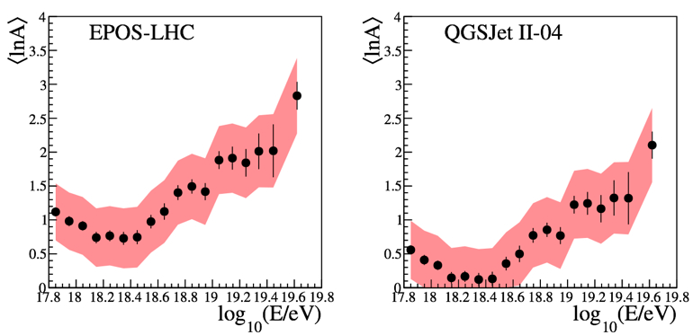
See Dembinski

Slide 49
See Dembinski
Fe
O
He
p

Slide 50
GZK
(TA ICRC11)
Kotera, AO ‘11

Slide 51
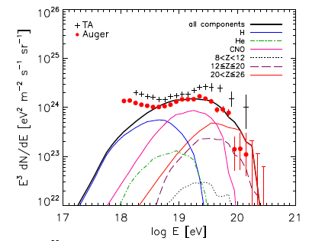
GZK vs E_{max}
(TA ICRC11)
Fang, Kotera, AO ‘13
Kotera, AO ‘11

Slide 52
Hillas Plot: E_{max} required
R_{L} < R_{source}
B/μG > (E_{max}/ Z EeV) (1.1kpc/R_{source})
LHC
LHC
white
dwarf
white
dwarf
Kotera & AO‘11
Notes:
Easier for Iron
LHC = 8.36 Tesla = 8.4 10^4 G, 27 km = 2.7 10^6 cm
G = 10^-4 T

Slide 53
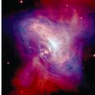
Birth of ultrafast spinning
Pulsars

Slide 54




Young Neutron Stars & Magnetars
M ~1 M_{solar} R~10km compact stars
Born Fast spinning <P> ~ 300 ms
– slows down due to magnetic breaking
(and gravitational radiation early one)
Born B ~ 10¹²⁻¹³ G
Open Lines
Ω
Closed Line
Blasi, Epstein & AVO ’00, Arons ‘03

Slide 55





Ex: Birth of ultrafast spinning Pulsars
Newborn Pulsar with:
At the light cylinder:
Magnetic wind can accelerate particles up to
Spectrum too hard:
Maximum Energy?✔
Spectrum is too hard ~ E⁻¹
Blasi, Epstein, AVO ‘00

Slide 56



Escape from Supernova Remnant:
softens the spectrum between protons and iron
+ pulsar distribution & propagation
maximum 10^{4.2}/s
maximum 10^{4.2}/s
Fang, Kotera, AVO ‘12

Slide 57



Fast Spinning Newborn Pulsars !
Fang, Kotera, AVO ‘13

Slide 58
Fast Spinning Newborn Pulsars !
Fang, Kotera, AVO ‘13

Slide 59


Galactic Cosmic Rays
mind the gap
Amato & Blasi ‘12
Fang, Kotera, AVO ‘13
Notes:
All-particle CR spectrum for ten random realizations of sources in the cylindrical model,
assuming δ = 1/3, a SN rate R = 1/100yr−1 (R = 1/30yr−1) on the left (right). The halo size is
H = 4 kpc. The injection spectrum of all chemicals is assumed to have a slope (below the cutoff)
such that γ + δ = 2.67.

Slide 60


Multimessenger Predictions
Fang, Kotera, Murase, AVO ‘13

Slide 61
Current Status
Leading Observatories:
  Pierre Auger Observatory: 3,000 km² Argentina
  Telescope Array: 700 km² Utah, USA
Agreement on the shape of the spectrum
Energy scale: 20% difference bet. Auger and TA
Composition: controversial
Anisotropies: hints above 60 EeV – no >3σ signal

Slide 62
Greisen-Zatsepin-Kuzmin effect

Slide 63
Greisen-Zatsepin-Kuzmin effect
Gpc
~100 Mpc
~10 Mpc

Slide 64
Greisen-Zatsepin-Kuzmin effect
Gpc
Isotropic
Isotropic
~100 Mpc
Anisotropic
~10 Mpc
Anisotropic

Slide 65


Slide 66



Auger: consistent with Anisotropy above 60 EeV
AGN catalog test

Slide 67


Dipole?

Slide 68



Telescope Array
TA & Swift BAT: 57 events E > 40 EeV
No significant
Correlation
– best w 60-month
SB AGN catalog,
P = 1.3 x 10⁻⁵
above 100 EeV
Auger/TA doublet
Troitsky ‘ May 29 ‘12
Notes:
Swift BAT (Burst Alert Telescope) 58-Month hard
144 X-ray survey catalog (SB-58M) (Baumgartner et al. 2010)
and 60-Month AGN survey
145 catalog (SB-AGN)

Slide 69
Current Status
Leading Observatories:
  Pierre Auger Observatory: 3,000 km² Argentina
  Telescope Array: 700 km² Utah, USA
Agreement on the shape of the spectrum
Energy scale: 20% difference bet. Auger and TA
Composition: controversial
Anisotropies: hints above 60 EeV – no >3σ signal
Need significant
INCREASE in STATISTICS E > 60 EeV = EECR
(extreme energy cosmic rays)

Slide 70

To detect sources
Observe at higher energies – fewer sources
D’Orfeuil et al 13

Slide 71
To detect sources
Observe at higher energies – fewer sources
D’Orfeuil et al 13

Slide 72
To detect sources
Increase statistics: ~1,000 events > 60 EeV
~100 events > 100 EeV
Proton rich
D’Orfeuil et al 13

Slide 73
To detect sources
Increase statistics: ~1,000 events > 60 EeV
~100 events > 100 EeV
Proton poor
D’Orfeuil et al 13

Slide 74
How to find the Sources?
GET A LOT MORE DATA above 60 EeV!!!!
GET ~ 1,000 events above 60 EeV!!!!
OVER THE WHOLE SKY !!!!

Slide 75
How many EECRs > 60 EeV?
Auger w/ 3,000 km²
~20 events > 60 EeV/ yr
Telescope Array w/ 700 km²
~5 events > 60 EeV/ yr
Auger + TA < 30 events/yr
Notes:
(Auger annual exposure of 6,000 km² sr yr)
(TA annual exposure of ~ 1,400 km² sr yr)
the exposure is expected to increase 454
by about 500 km2 sr yr per month.
arXiv:1111.6764v1

Slide 76
How many EECRs > 60 EeV?
Auger w/ 3,000 km²
~20 events > 60 EeV/ yr
Telescope Array w/ 700 km²
~5 events > 60 EeV/ yr
Auger + TA < 30 events/yr
30+ years to reach 1,000
Notes:
(Auger annual exposure of 6,000 km² sr yr)
(TA annual exposure of ~ 1,400 km² sr yr)
the exposure is expected to increase 454
by about 500 km2 sr yr per month.
arXiv:1111.6764v1

Slide 77

How many EECRs > 60 EeV?
Auger w/ 3,000 km²
~20 events > 60 EeV/ yr
Telescope Array w/ 700 km²
~5 events > 60 EeV/ yr
Auger + TA < 30 events/yr
30+ years to reach 1,000
Earth - surface ~ 5 10⁸ km²
~3.4 10⁶ events/yr
Notes:
(Auger annual exposure of 6,000 km² sr yr)
(TA annual exposure of ~ 1,400 km² sr yr)
the exposure is expected to increase 454
by about 500 km2 sr yr per month.
arXiv:1111.6764v1

Slide 78
How many EECRs > 60 EeV?
Auger w/ 3,000 km²
~20 events > 60 EeV/ yr
Telescope Array w/ 700 km²
~5 events > 60 EeV/ yr
Auger + TA < 30 events/yr
Earth - surface ~ 5 10⁸ km²
~3.4 10⁶ events/yr
5 o.o.m to go!
Notes:
(Auger annual exposure of 6,000 km² sr yr)
(TA annual exposure of ~ 1,400 km² sr yr)
the exposure is expected to increase 454
by about 500 km2 sr yr per month.
arXiv:1111.6764v1

Slide 79
Go to SPACE!
To look down on the
Atmosphere!

Slide 80
How many UHECRs > 60 EeV?
Auger + TA ~30 events/yr
JEM-EUSO
~200 events > 60 EeV/yr
Earth - surface ~ 5 10⁸ km²
~3.4 10⁶ events/yr
Notes:
the exposure is expected to increase 454
by about 500 km2 sr yr per month.
arXiv:1111.6764v1

Slide 81
How many UHECRs > 60 EeV?
Auger + TA ~30 events/yr
JEM-EUSO
~200 events > 60 EeV/yr
Earth - surface ~ 5 10⁸ km²
~3.4 10⁶ events/yr
4 o.o.m to go!
Notes:
the exposure is expected to increase 454
by about 500 km2 sr yr per month.
arXiv:1111.6764v1

Slide 82

JEM-EUSO Mission
Extreme Universe Space Observatory (EUSO)
in the Japanese Experiment Module (JEM)
of the International Space Station (ISS)

Slide 83





JEM-EUSO
Japan, USA, Korea, Mexico, Russia, (Algeria)
Europe: Bulgaria, France, Germany, Italy, Poland, Slovakia, Spain, Switzerland, (Sweden)
13(+2) Countries, 300 researchers
Leading institution: RIKEN
PI: Piergiorgio Picozza

Slide 84





“Cosmic Ray Observatory on the ISS”
View from NASA: “Cosmic Ray Observatory on the ISS”
ISS-CREAM
Sp-X Launch 2014
AMS Launch
May 16, 2011
JEM-EUSO
Launch Tentatively
planned for 2017
CALET on JEM
HTV Launch 2014

Slide 85

JEM-EUSO goals
- pioneer the study of EECR from Space
- increase exposure to EECR by 1 order of magnitude
- discover the nearby sources of UHECRs

Slide 86






Fluorescence
from SPACE
J. Linsley
Y. Takahashi
Nadir
Tilt
Nadir
Tilt

Slide 87
JEM-EUSO Mission
Parameter | Value
Launch date | 2017
Mission Lifetime | 3+2 years
Rocket | H2B or Falcon9
Transport Vehicle | HTV or Dragon
Accommodation on JEM | EF#9
Mass | ~1200 kg
Power | 926 W (op.) 352 W (non op.)
Data rate | 285 kbps (+ on board storage)
Orbit | ~400 km
Inclination of the Orbit | 51.6°
Operation Temperature | -10° to +50°

Slide 88


Full Sky Coverage with nearly uniform exposure
The ISS ORBIT
http://www.nlsa.com/
Inclination: 51.6°
Height: ~400km

Slide 89


JEM-EUSO
Sky Coverage

Slide 90


Slide 91




H-II Transfer Vehicle (HTV)
HTV is 4m across ~10 m long
©JAXA

Slide 92




Slide 93


SpaceX
Dragon

Slide 94





Slide 95


Slide 96
The UV Telescope Parameters
Parameter | Value
Field of View | ±30°
Monitored Area | >1.3×10⁵km²
Telescope aperture | ≥2.5 m
Operational wavelength | 300-400 nm
Resolution in angle | 0.075°
Focal Plane Area | 4.5 m²
Pixel Size | <3 mm
Number of Pixels | ≈3×10⁵
Pixel size on ground | ≈560 m
Time Resolution | 2.5 μs
Dead Time | <3%
Photo-detector Efficiency | ≥20%
Notes:
Energy resolution 30% xmax 100 g
95

Slide 97














Payload
DAQ Electronics
Optics
Rear Fresnel Lens
Precision Fresnel lens
Support Structure
Iris
Front Fresnel lens
Telescope Structure
Focal Surface Detector
On-board Calibration
BUS System : JAXA
Housekeeping
Ground Based Calibration
Atmospheric Monitoring
Ground Support Equipment
Simulation : Worldwide
Notes:
96

Slide 98

Payload
DAQ Electronics
Optics
Rear Fresnel Lens
Precision Fresnel lens
Support Structure
Iris
Front Fresnel lens
Telescope Structure
Focal Surface Detector
On-board Calibration
BUS System : JAXA
Housekeeping
Ground Based Calibration
Atmospheric Monitoring
Ground Support Equipment
Simulation : Worldwide
Notes:
97

Slide 99



Slide 100


Notes:
multianode PMT

Slide 101
The UV Telescope Parameters
Parameter | Value
Field of View | ±30°
Monitored Area | >1.3×10⁵km²
Telescope aperture | ≥2.5 m
Operational wavelength | 300-400 nm
Resolution in angle | 0.075°
Focal Plane Area | 4.5 m²
Pixel Size | <3 mm
Number of Pixels | ≈3×10⁵
Pixel size on ground | ≈560 m
Time Resolution | 2.5 μs
Dead Time | <3%
Photo-detector Efficiency | ≥20%
Notes:
Energy resolution 30% xmax 100 g
100

Slide 102
Notes:
multianode PMT

Slide 103

FAST SIGNAL
a) Fluorescence
duration 50 -150 μs
b) Scattered Cherenkov
c) Direct (diffusively reflected Cherenkov)
p, 10²⁰eV, 60 deg
1 GTU gate time units = 2.5 μs
Background: 500 /m² sr ns
Notes:
Simulation on ESAF = EUSO Simulation and Analysis Framework, ESAF

Slide 104



Shower Simulation
Simulated air shower image on the focal surface detector.
2x10²⁰eV
65 deg
64 pixel
MAPMT
Detected photoelectrons are recorded every Gate Time Unit (GTU) of 2.5μs continuously.
10²⁰eV
60 deg

Slide 105


Imaging the Extreme Universe:
Solid-state cameras for Astroparticle Physics

Slide 106

JEM-EUSO
annual exposure =
10 x Auger
6 10⁴ km² sr yr

Slide 107

ZeV neutrino sensitivity
JEM-EUSO Nadir
IceCube reported First 28 neutrino events at High Energies
JEM-EUSO Tilt
ARA
ARIANA
3 yr

Slide 108

Next Generation GZK Neutrino Detectors
Current Limits
Flux Lower Limit

Slide 109

Order of magnitue increase in Exposure

Slide 110
In a decade, we can probe
particle interactions at
>300 TeV CM
from Space!!!
109

Slide 111


Obrigada!

Slide 113

Showers in ~1 PDM

Slide 114




Atmospheric Luminous Phenomena
Lightning picture observed from ISS
OH airglow observed from ground
Leonid meteor swarm in 2001 taken by Hivison camera
Various transient airglows
Notes:
113

Slide 115


Ultraluminous Supernovae
Kotera, Phinney, AVO ‘13

