Slide 1
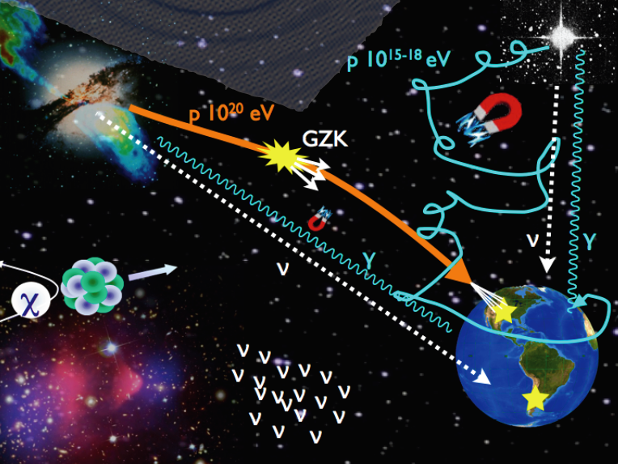
Cosmic Particles
Angela V. Olinto
University of Chicago

Slide 2
Outline
- The Cosmic Particles (Astroparticles)
- Big Questions/Unifying Themes
- Current Detectors
- Future Detectors

Slide 3
The Cosmic Particles (Astroparticles)

Slide 4
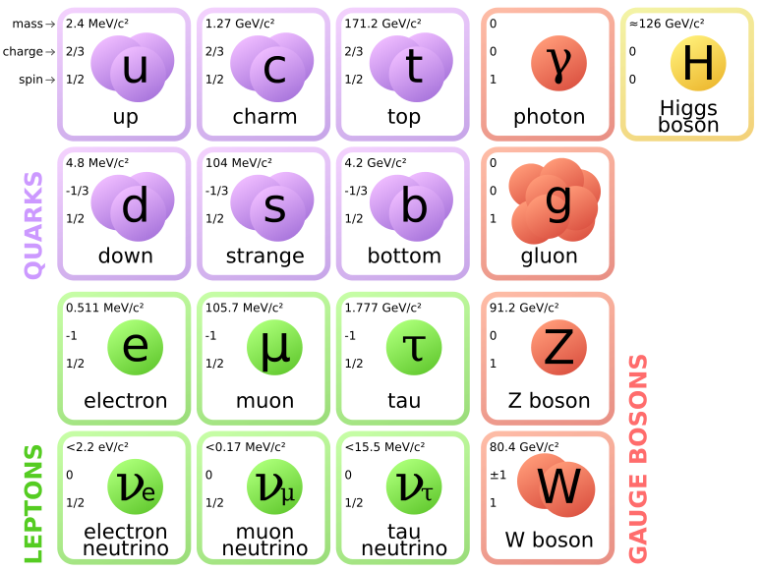
Standard Model

Slide 5
Cosmic Particles

Slide 6
What is the easiest Cosmic Particle or “Astroparticle” to detect?

Slide 7
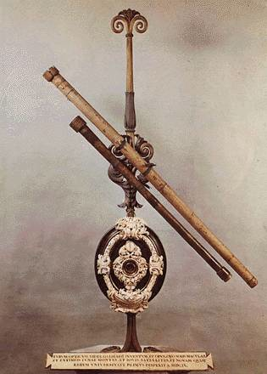
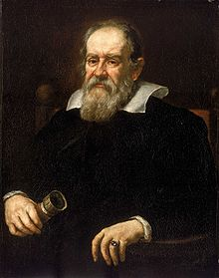
What is the easiest Cosmic Particle or “Astroparticle” to detect? Photon!

Slide 8
What is the easiest Cosmic Particle or “Astroparticle” to detect? Photon!
In what Energy range do we observe them?

Slide 9
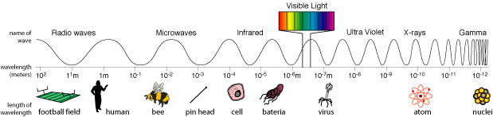
What is the easiest Cosmic Particle or “Astroparticle” to detect? Photon!
In what Energy range do we observe them?

Slide 10
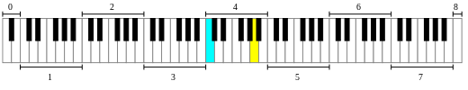
What is the easiest Cosmic Particle or “Astroparticle” to detect? Photon!
In what Energy range do we observe them?
15 o.o.m.
6 pianos

Slide 11
What is the easiest Cosmic Particle or “Astroparticle” to detect? Photon!
In what Energy range do we observe them?
10⁻⁹ eV to 10¹⁴ eV (1 eV = 2.4 10¹⁴ Hz)
9 pianos
MeV
100 TeV
GammaRays

Slide 12
What is the easiest Cosmic Particle or “Astroparticle” to detect? Photon!
In what Energy range do we observe them?
10⁻⁹ eV to 10¹⁴ eV (1 eV = 2.4 10¹⁴ Hz)
How far can we observe them from?

Slide 13
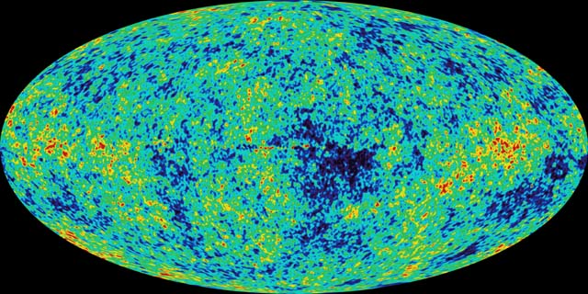
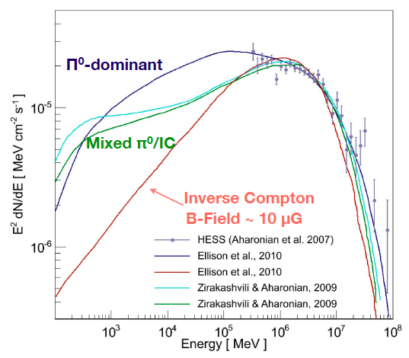
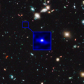
What is the easiest Cosmic Particle or “Astroparticle” to detect? Photon!
In what Energy range do we observe them?
10⁻⁹ eV to 10¹⁴ eV (1 eV = 2.4 10¹⁴ Hz)
How far can we observe them from?
Energy Dependent z = 1100 (E_{cmb}~ 10⁻³ eV)
Galactic Sources (E ~ 100 TeV)
z=10
UDFj-39546284

Slide 14
RX J1713.7-3946

Slide 15
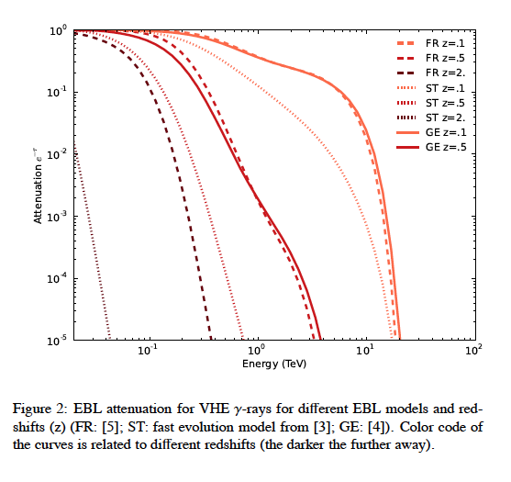
Mazin et al 2013

Slide 16
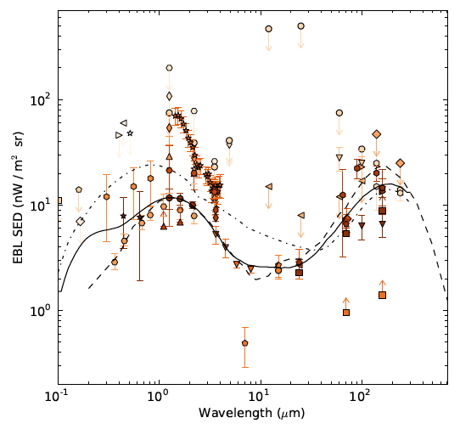

Slide 17
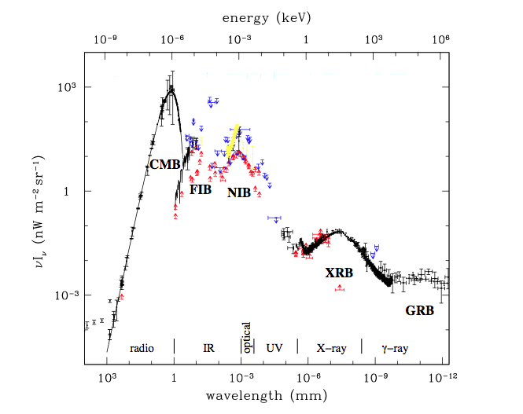
Mo et al’ 10

Slide 18
What is the easiest Cosmic Particle or “Astroparticle” to detect? Photon!
In what Energy range do we observe them?
10⁻⁹ eV to 10¹⁴ eV (1 eV = 2.4 10¹⁴ Hz)
How far can we observe them from? z = 1100 (E_{cmb}~ 10⁻³ eV)
Galactic Sources (E ~ 100 TeV)
At High Energies, how are they generated?

Slide 19
What is the easiest Cosmic Particle or “Astroparticle” to detect? Photon!
In what Energy range do we observe them?
10⁻⁹ eV to 10¹⁴ eV (1 eV = 2.4 10¹⁴ Hz)
How far can we observe them from? z = 1100 (E_{cmb}~ 10⁻³ eV)
Galactic Sources (E ~ 100 TeV)
At High Energies, how are they generated?
Electromagnetic & Hadronic (π prod) processes

Slide 20
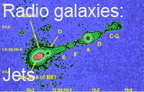
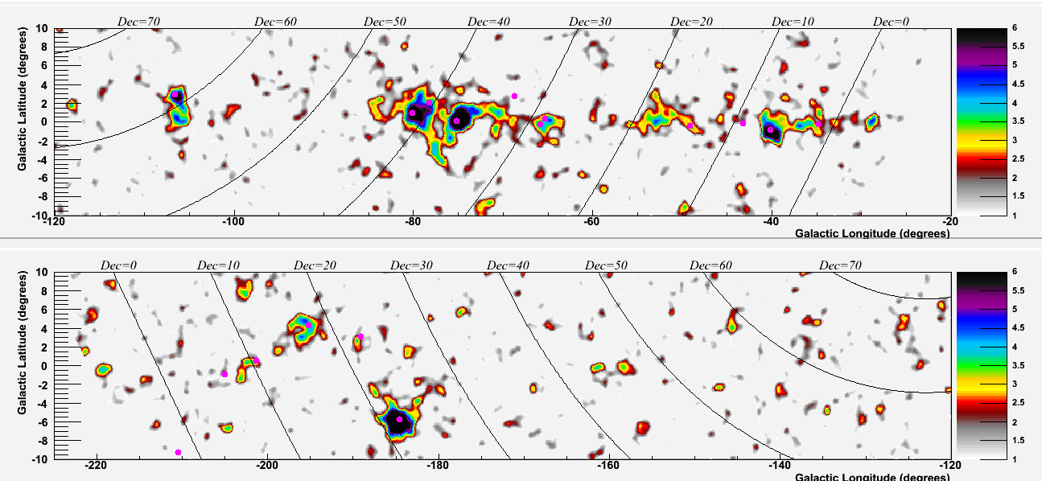


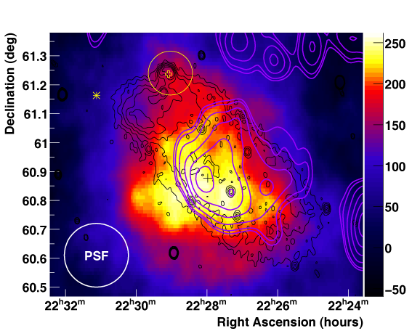

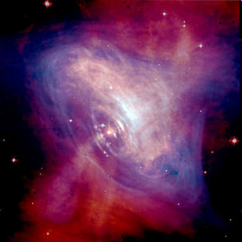

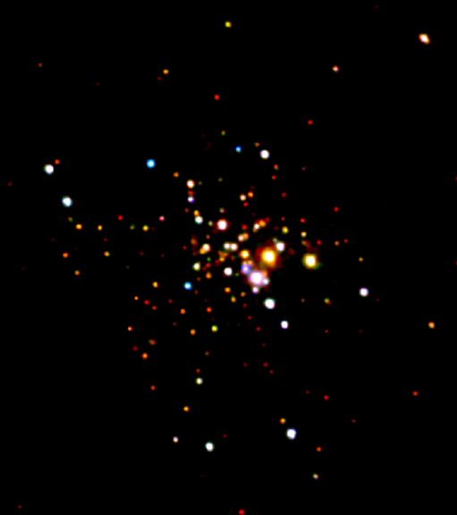
Nature’s HE γAccelerators
Extragalactic
  Supernova
  remnants
Galactic
  Pulsar wind
  nebulae
PSR J2021+3651
0FGL J0634+1745
GR Pulsars
Unidentified
  Stellar
  clusters
Krennrich, Hoffman TeVPA09

Slide 21
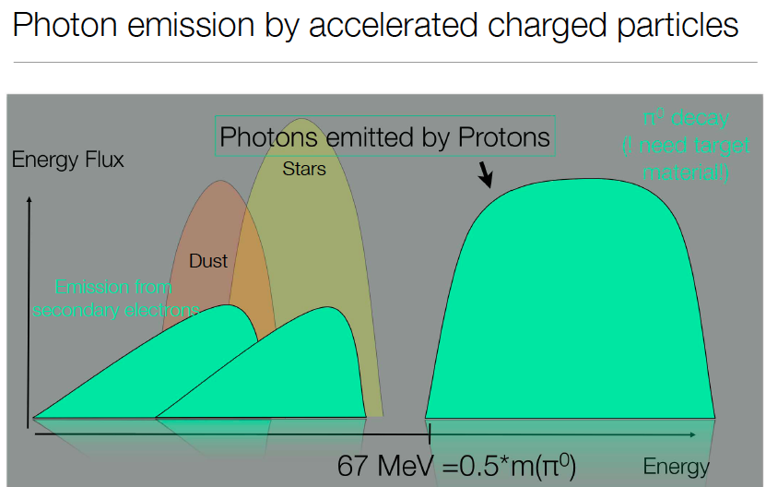
S. Funk CR2012

Slide 22
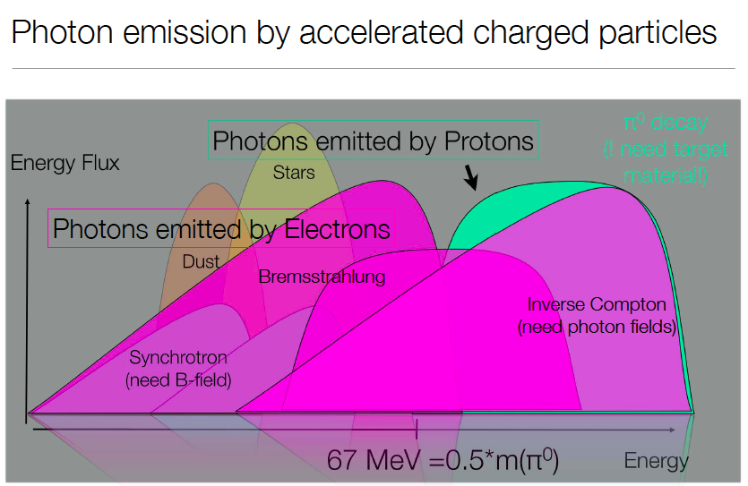
S. Funk CR2012

Slide 23
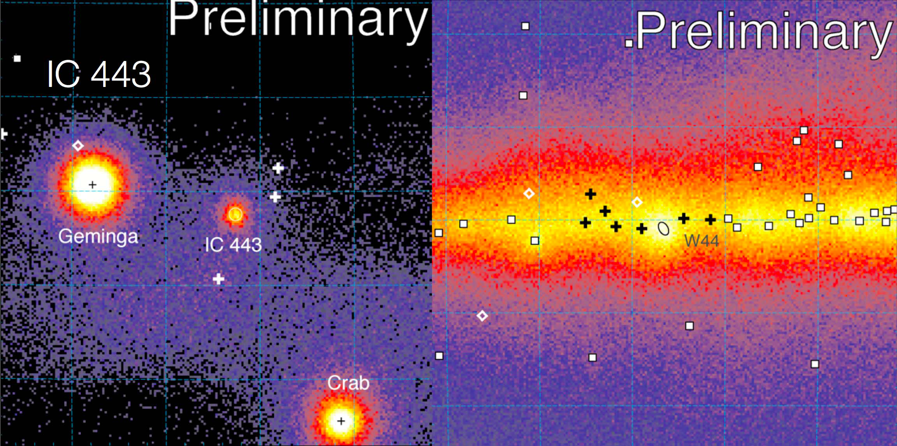
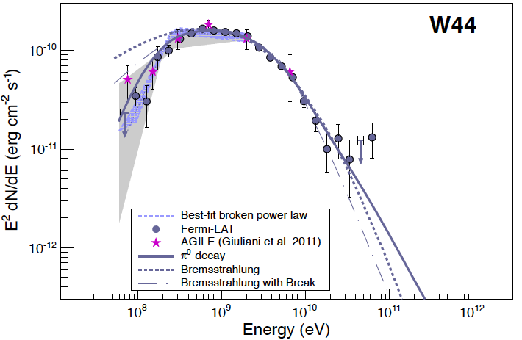
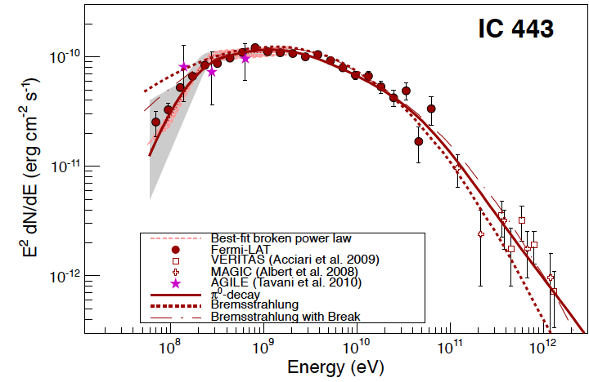
π⁰ decay!
IC 443 & W44
Fermi & AGILE
Bremsstrahlung
Bremsstrahlung
π⁰ decay
Ackermann et al (Fermi Collab) ‘13

Slide 24
What is the easiest Cosmic Particle or “Astroparticle” to detect? Photon!
In what Energy range do we observe them?
10⁻⁹ eV to 10¹⁴ eV (1 eV = 2.4 10¹⁴ Hz)
How far can we observe them from? z = 1100 (E_{cmb}~ 10⁻³ eV)
Galactic Sources (E ~ 100 TeV)
At High Energies, how are they generated?
Electromagnetic & Hadronic (π prod) processes
At High Energies, how are they observed?

Slide 25
What is the easiest Cosmic Particle or “Astroparticle” to detect? Photon!
In what Energy range do we observe them?
10⁻⁹ eV to 10¹⁴ eV (1 eV = 2.4 10¹⁴ Hz)
How far can we observe them from? z = 1100 (E_{cmb}~ 10⁻³ eV)
Galactic Sources (E ~ 100 TeV)
At High Energies, how are they generated?
Electromagnetic & Hadronic (π prod) processes
At High Energies, how are they observed?
Fermi Satellite, IACTs, Water

Slide 26
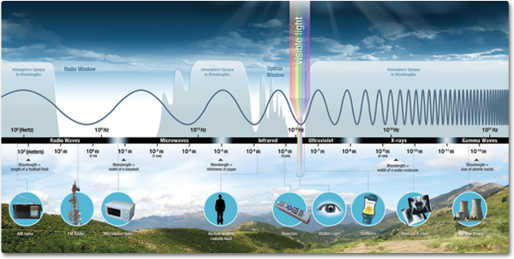

Slide 27
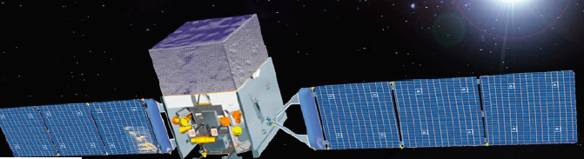
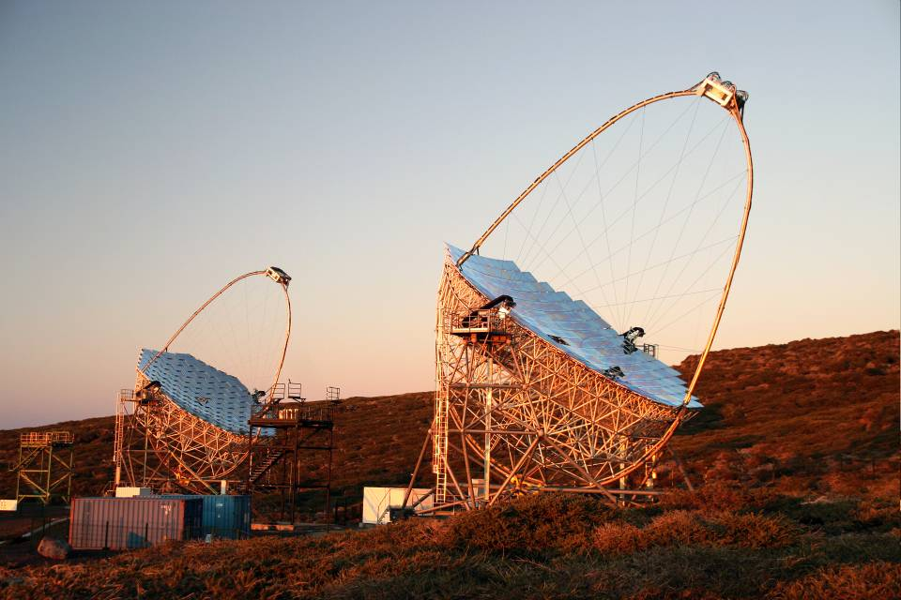
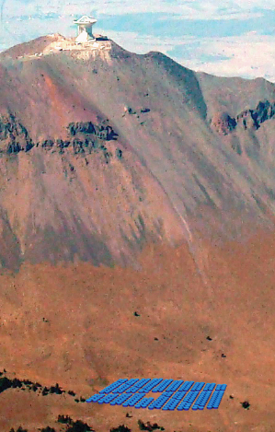
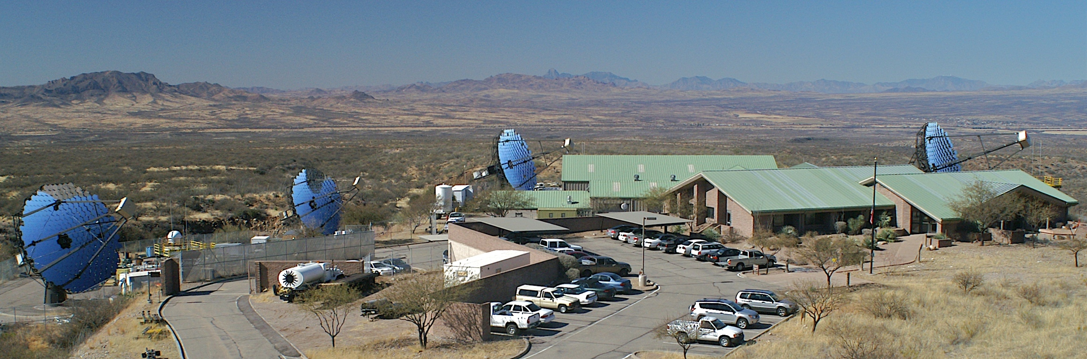
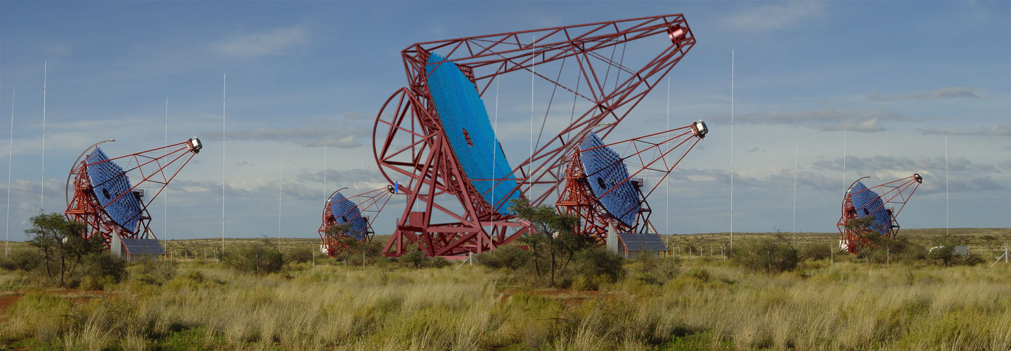
Gamma-Rays Eyes
Fermi
MAGIC II
Fermi GST
LAT:
20 MeV - >300 GeV
GBM
8 keV - 40 MeV
VERITAS
HAWC
~10¹⁴ eV
HESS II
Notes:
Large Area Telescope, GRB monitor

Slide 28
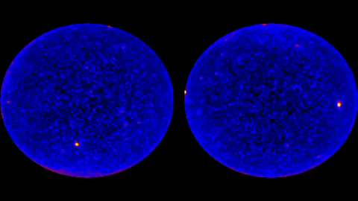
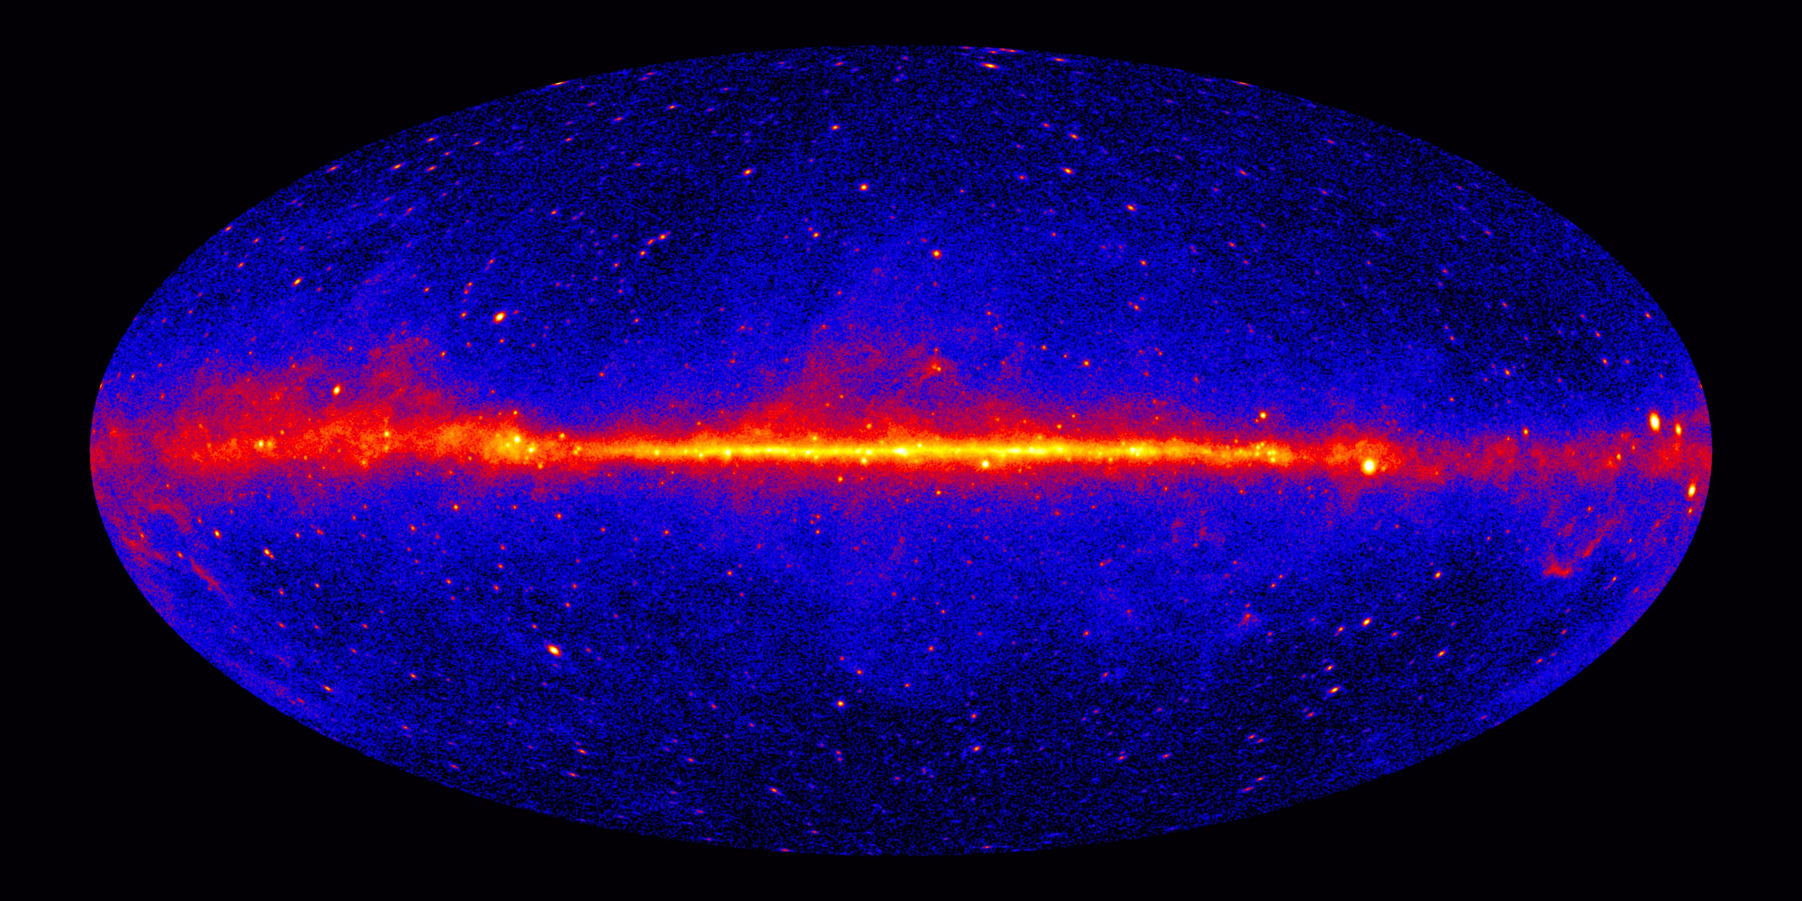
Fermi

Slide 29
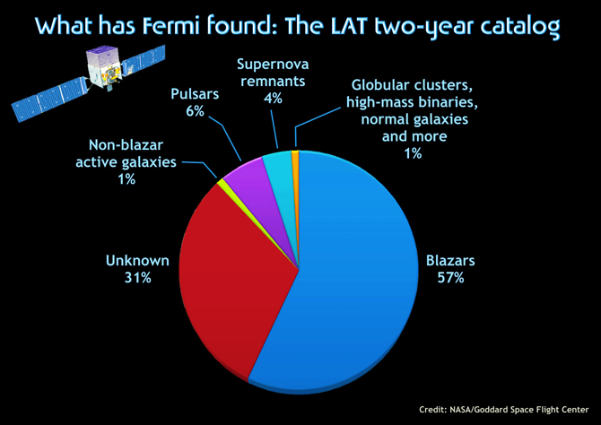

Slide 30
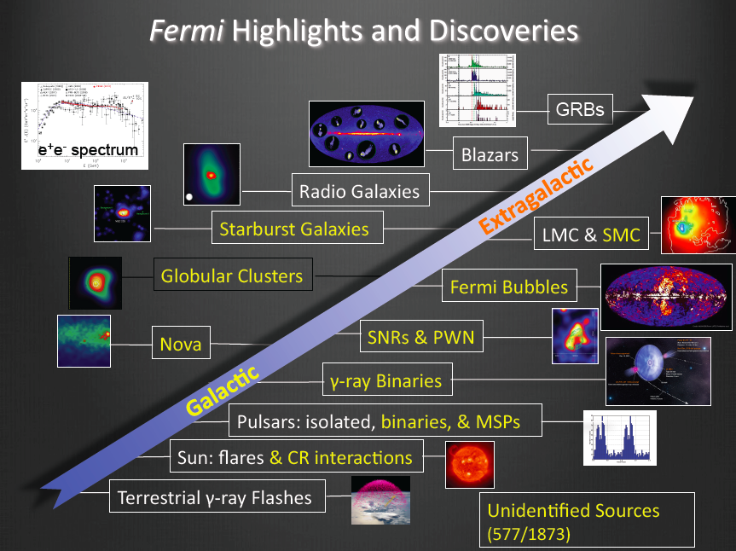
J. McEnery ICRC13

Slide 31
Gamma-Rays Eyes
Fermi
MAGIC
IACT –
Imaging Atmospheric
Cherenkov Telescopes
~10¹⁰ to <10¹⁴ eV
VERITAS
HESS
HAWC
~10¹⁴ eV
Notes:
High-Altitude Water Cherenko

Slide 32
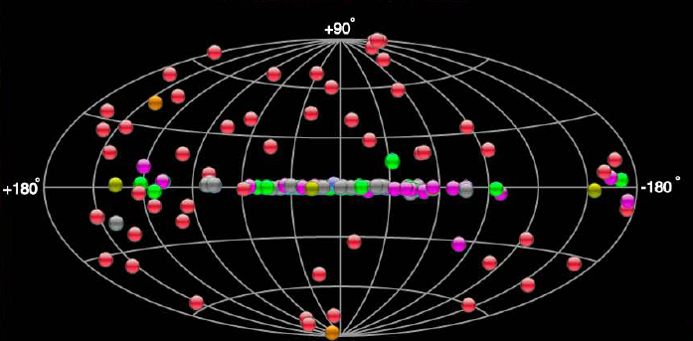
TeV γCatalog (IACT sky)
145 sources
tevcat.uchicago.edu

Slide 33
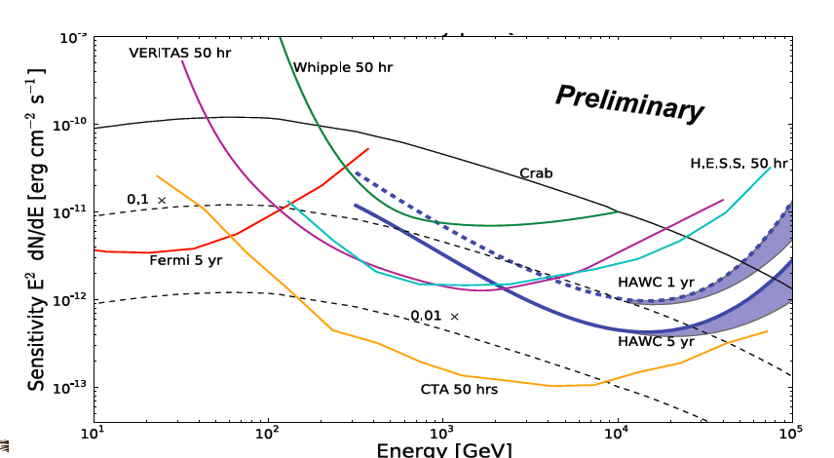

Slide 34
What is the easiest Cosmic Particle or “Astroparticle” to detect? Photon!
In what Energy range do we observe them?
10⁻⁹ eV to 10¹⁴ eV (1 eV = 2.4 10¹⁴ Hz)
How far can we observe them from? z = 1100 (E_{cmb}~ 10⁻³ eV)
Galactic Sources (E ~ 100 TeV)
At High Energies, how are they generated?
Electromagnetic & Hadronic (π prod) processes
At High Energies, how are they observed?
Fermi Satellite, IACTs, Water
Can they be observed at UHEs?

Slide 35
What is the easiest Cosmic Particle or “Astroparticle” to detect? Photon!
In what Energy range do we observe them?
10⁻⁹ eV to 10¹⁴ eV (1 eV = 2.4 10¹⁴ Hz)
How far can we observe them from? z = 1100 (E_{cmb}~ 10⁻³ eV)
Galactic Sources (E ~ 100 TeV)
At High Energies, how are they generated?
Electromagnetic & Hadronic (π prod) processes
At High Energies, how are they observed?
Fermi Satellite, IACTs, Water
Can they be observed at UHEs?
Maybe, from nearby sources

Slide 36
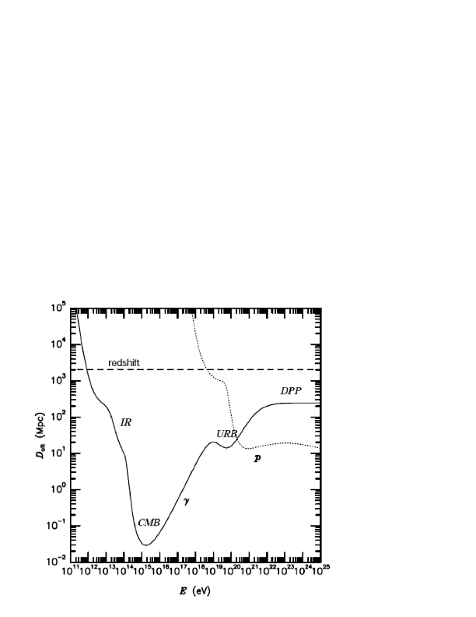
Gamma Ray Attenuation

Slide 37
The UHE Gamma Ray Astronomical Window
Photon attenuation length
> 10 Mpc for E > 2 EeV

Slide 38
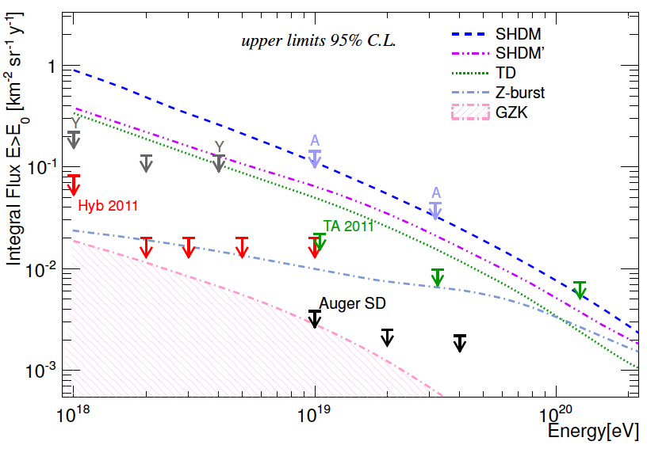
Auger Photon Limits
Auger
Auger Moriond 2013

Slide 39
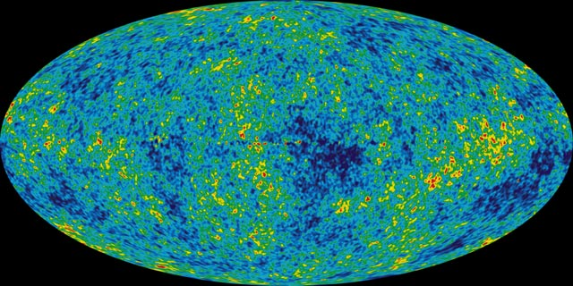
Cosmogenic (GZK) Neutrinos & Photons
and UHECR composition
p+γ_{cmb}→ Δ⁺ → p + π⁰ → γγ
→ n + π ⁺
n → p + e⁻ + ν_{e}
π⁺ → μ⁺ + ν_{μ}
μ ⁺ → e⁺ + ν_{e} +ν_{μ}

Slide 40
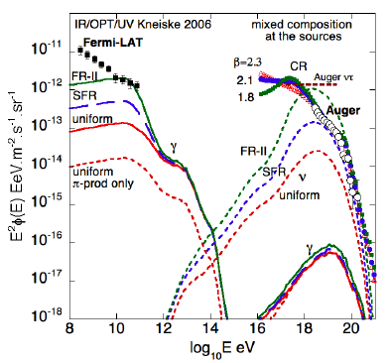
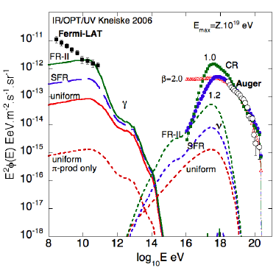
GZK/Cosmogenic Photons
Low E_{max}
Decerprit & Allard 11

Slide 41
What are the most energetic Cosmic Particles ever detected?

Slide 42
What are the most energetic Cosmic Particles ever detected? Cosmic Rays of Ultra High Energies (UHECRs)

Slide 43

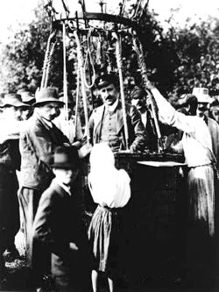
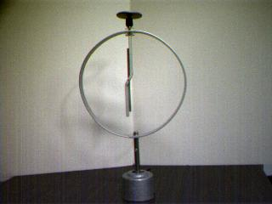
101th Anniversary
+
1911-1912:
Victor Hess studies the discharge of electroscopes as a function of altitude reaching 5,300 meters in a balloon!
Victor Hess balloon flights – 1912
establishes the cosmic nature of ionizing radiation
Notes:
Victor Hess getting ready to measure cosmic rays, Austria, 1912.

Slide 44
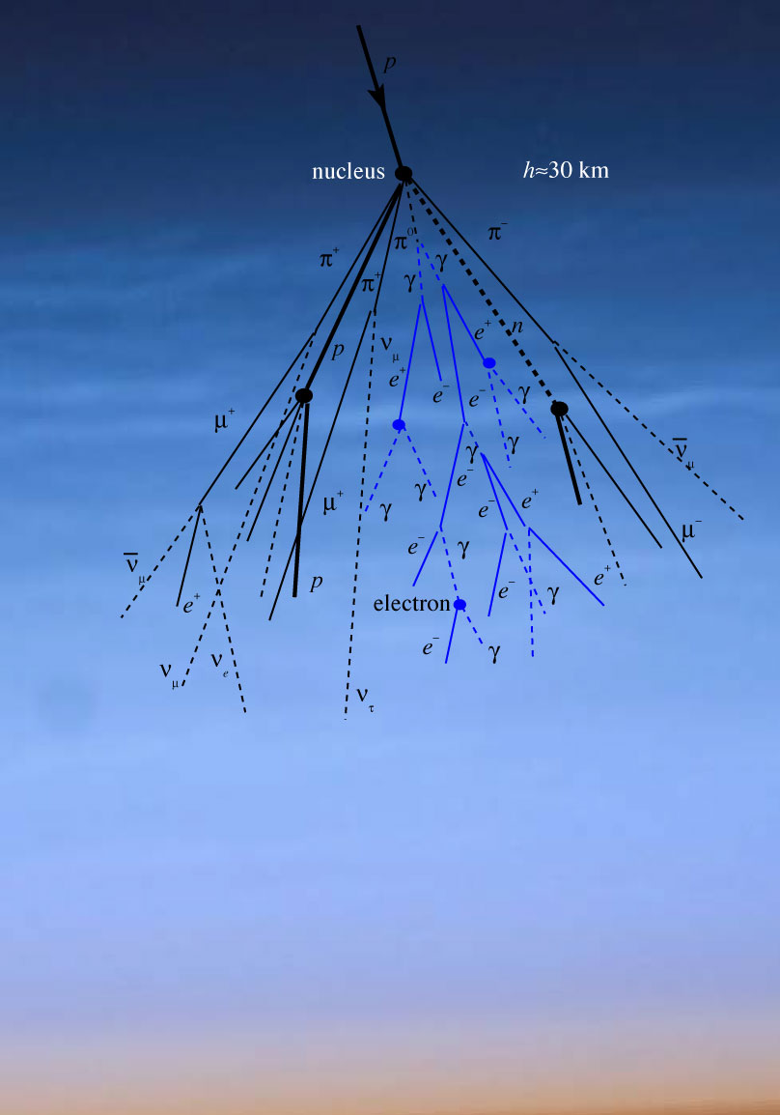
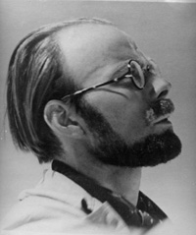
Pierre Victor Auger
(1899 - 1993)
1937: Discovery of Extensive AirShowers.
array of Geiger counters showed simultaneous events at much higher rate than expected due to coincidences.
Cosmic rays can reach the Earth with Energy ~ 10¹⁵ eV.

Slide 45
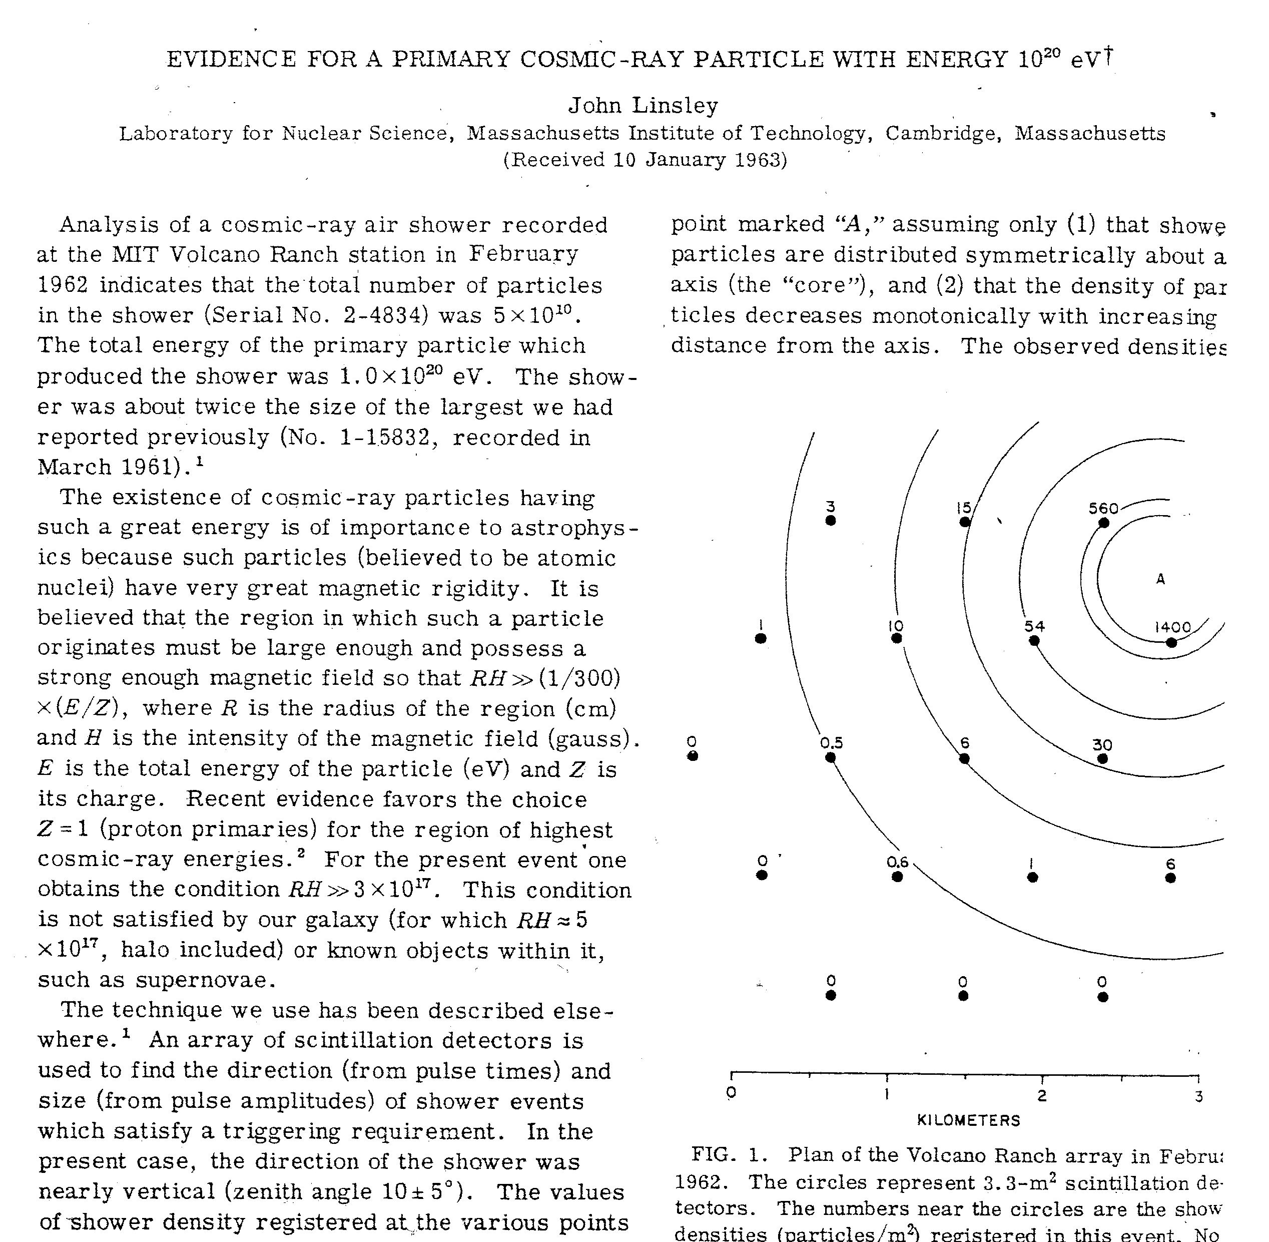
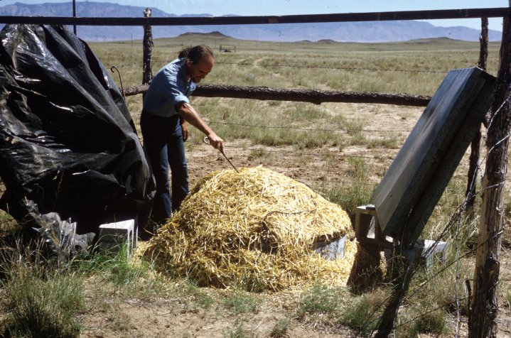
1962 John Linsley’s observation of a 10²⁰ eV event

Slide 46
What are the most energetic Cosmic Particles ever detected? Cosmic Rays of Ultra High Energies (UHECRs)
In what Energy range do we observe Cosmic Rays?

Slide 47
What are the most energetic Cosmic Particles ever detected? Cosmic Rays of Ultra High Energies (UHECRs)
In what Energy range do we observe Cosmic Rays? from 0.1 GeV to 0.3 ZeV or from 10⁸ to 10²⁰ eV
12 pianos
Cosmic Rays
GammaRays

Slide 48
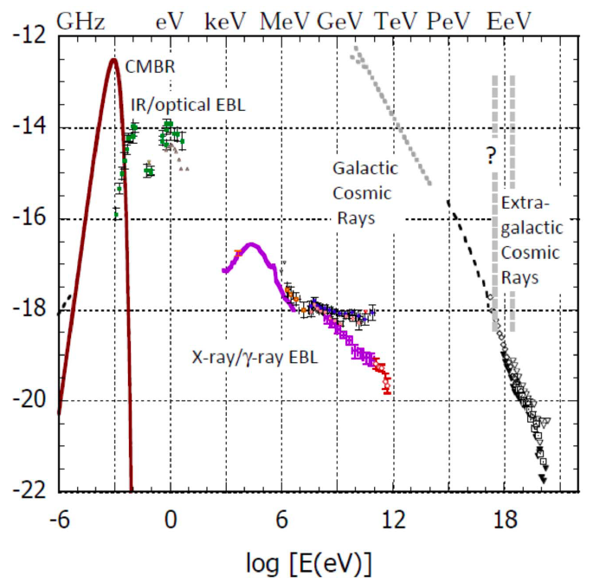

Dermer & Menon ‘11

Slide 49
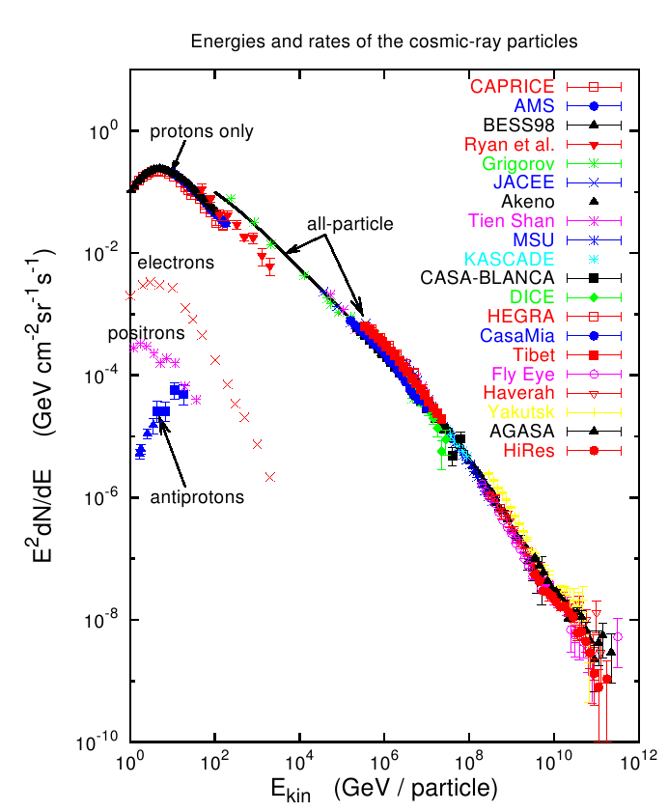

Slide 50
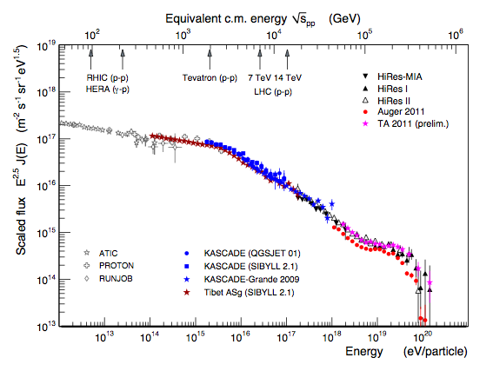

Slide 51
What are the most energetic Cosmic Particles ever detected? Cosmic Rays of Ultra High Energies (UHECRs)
In what Energy range do we observe Cosmic Rays? from 0.1 GeV to 0.3 ZeV or from 10⁸ to 10²⁰ eV
How far can we observe them from?

Slide 52
What are the most energetic Cosmic Particles ever detected? Cosmic Rays of Ultra High Energies (UHECRs)
In what Energy range do we observe Cosmic Rays? from 0.1 GeV to 0.3 ZeV or from 10⁸ to 10²⁰ eV
How far can we observe them from? Galactic E < 10¹⁷ eV ???
Extragalactic E > EeV = 10¹⁸ eV; z_{sources} = 10?
E > 50 EeV, distances of < 100 Mpc

Slide 53
“Known unknown”
Cosmic Magnetic Fields
R_{L} = kpc Z⁻¹ (E / EeV) (B / μG)⁻¹
R_{L} = Mpc Z⁻¹ (E / EeV) (B / nG)⁻¹
1 EeV = 10¹⁸ eV
γ
Extra-galactic B?
B < nG
weak deflection
E > 10¹⁹eV
Halo B?
strong deflection
E < 10¹⁸eV
Milky way
B ~ μG
kpc
10 kpc

Slide 54
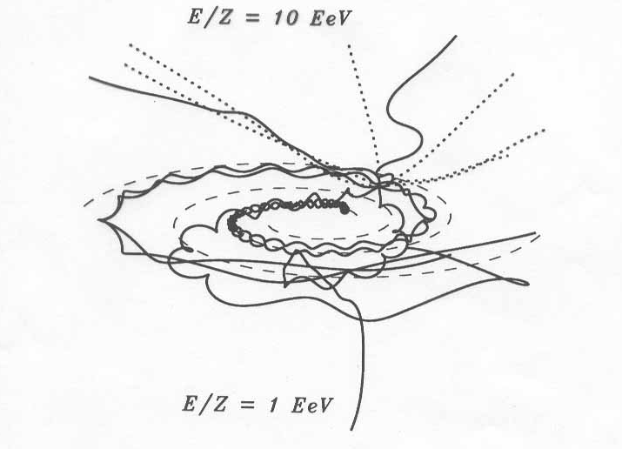
UHECR trajectories in Galactic B
1 EeV=10¹⁸ eV

Slide 55
What are the most energetic Cosmic Particles ever detected? Cosmic Rays of Ultra High Energies (UHECRs)
In what Energy range do we observe Cosmic Rays? from 0.1 GeV to 0.3 ZeV or from 10⁸ to 10²⁰ eV
How far can we observe them from? Galactic E < 10¹⁷ eV ???
Extragalactic E > EeV = 10¹⁸ eV; z_{sources} = 10?
E > 50 EeV, distances of < 100 Mpc

Slide 56
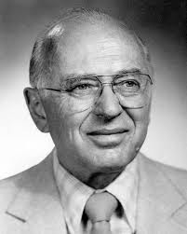






Propagation of UHECRs
Greisen-Zatsepin-Kuzmin (GZK)
pioneered the field in 1966
protons & nuclei

Slide 57
“Cosmologically Meaningful Termination”
p+γ_{cmb}→ Δ⁺ → p + π⁰
→ n + π ⁺
Proton Horizon
~10²⁰ eV
GZK Cutoff
Greisen, Zatsepin, Kuzmin
1966

Slide 58

GZK effect for protons

Slide 59

Propagation of UHE protons
Modification factor
Berezinsky, Gazizov, Grigoriev ‘05

Slide 60
Propagation of UHE protons
Modification factor
SpectrumRecovery
Berezinsky, Gazizov, Grigoriev ‘05

Slide 61



Propagation of UHE nuclei
GDR: giant dipolar resonance
QD: quasi-deuteron process
BR: baryonic resonances
PF: photo-fragmentation
⁵⁶Fe mean-free-path
CMB IRB interaction
Energy Loss Length
dip only for protons
Allard, Parizot, Khan, Goriely, AVO ‘05
Notes:
GDR: giant dipolar resonance
QD: quasi-deuteron process
BR: baryonic resonances
PF: photo-fragmentation
propagation: CMB and infrared background (IRB).

Slide 62

GZK Horizon
Allard, AVO, Parizot ‘07

Slide 63

GZK Horizon
Allard, AVO, Parizot ‘07

Slide 64

Modern Propagation Codes
Public:
CRPropa
1.0 Armengaud et al ‘06
2.0 Kampert et al. ’12
3.0 Alvez Batista et al ’13
SimProp
Aloisio et al ’12
Private:
Allard et al ’04
Taylor ’07
Ahlers ‘10
others...

Slide 65
Modern Propagation Codes
InterGal
Magnetic Fields
Interaction Cross Sections, z evolution
Background Fields: CMB, UV/Opt/IR
Primary, Secondary nuclei, nucleons,
e+e-, gamma-rays, neutrinos,...

Slide 66


Source Model:
injection spectrum:E^{-s}
injected composition
redshift distribution
Spectrum
Anisotropies
Propagation Codes
Composition
InterGal
Magnetic Fields
Interaction Cross Sections, z evolution
Background Fields: CMB, UV/Opt/IR
Primary, Secondary nuclei, nucleons,
e+e-, gamma-rays, neutrinos,...
Multi-messengers

Slide 67
What are the most energetic Cosmic Particles ever detected? Cosmic Rays of Ultra High Energies (UHECRs)
In what Energy range do we observe Cosmic Rays? from 0.1 GeV to 0.3 ZeV or from 10⁸ to 10²⁰ eV
How far can we observe them from? Galactic E < 10¹⁷ eV ???
Extragalactic E > EeV = 10¹⁸ eV; z_{sources} = 10?
E > 50 EeV, distances of < 100 Mpc
How are they observed?

Slide 68
What are the most energetic Cosmic Particles ever detected? Cosmic Rays of Ultra High Energies (UHECRs)
In what Energy range do we observe Cosmic Rays? from 0.1 GeV to 0.3 ZeV or from 10⁸ to 10²⁰ eV
How far can we observe them from? Galactic E < 10¹⁷ eV ???
Extragalactic E > EeV = 10¹⁸ eV; z_{sources} = 10?
E > 50 EeV, distances of < 100 Mpc
How are they observed?
Detectors in Balloons, Space, Underground, Giant Ground Arrays

Slide 69


Slide 70





“Cosmic Ray Observatory on the ISS”
“Cosmic Ray Observatory on the ISS”
ISS-CREAM
Sp-X Launch 2014
AMS Launch
May 16, 2011
JEM-EUSO
Launch Tentatively
planned for 2017
CALET on JEM
HTV Launch 2014

Slide 71


Recent Highlights (April 3, 2013)
AMS first results
PRL 110, 141102 (2013)
Notes:
Linsley, J. 1963, Phys. Rev. Lett., 10, 146
Bird, D. J. et al. 1994, Astrophys. J., 424, 491
Takeda, M. et al. 1998, Physical Review Letters, 81, 1163
Abbasi, R. U. et al. 2004, Physical Review Letters, 92, 151101

Slide 72

Ultrahigh Energy Cosmic Rays
Leading Observatories
Telescope Array
Utah, USA
700 km² array
3 fluorescence sites
Pierre Auger
Observatory
Mendoza, Argentina
3 000 km² array
4 fluorescence sites

Slide 73

The Pierre Auger Observatory
Argentina
Australia
Brasil
Bolivia*
Croatia
Czech Rep.
France
Germany
Italy
Mexico
Netherlands
Poland
Portugal
Romania*
Slovenia
Spain
UK
USA
Vietnam*
*Associate Countries
3,000 km² water cherenkov detectors array
4 fluorescence Telescopes
Malargue, Argentina
Notes:
19 countries, truly international

Slide 74

surface detector

Slide 75

array of tanks

Slide 76





4 times 6 telescopes overlooking the site

Slide 77


Slide 78





Telescope Array
Belgium
Japan
Korea
Russia
USA
Area: 680 km²
3 FD stations overlooking an array of
507 scintillator surface detectors (SD)
complete and operational as of ~1/2008.

Slide 79

Deployment (up to 50/day) 485 SDs: 10/2006 - 3/2007

Slide 80

2012 CERN
Working Group
Unified Spectrum
20% energy shifts,

Slide 81
To fit the spectrum, need:
injection spectrum: E^{-s}, E_{max}
injection composition
Transition Gal/Extragal model
Source evolution: FRII, SFR, uniform
Kotera, AO ‘11

Slide 82


Kotera, AO 2011

Slide 83
To fit the spectrum, need:
injection spectrum: E^{-s}, Emax
injection composition
Transition Gal/Extragal model
Source evolution: FRII, SFR, uniform
MANY WAYS TO FIT THE SPECTRUM!
Kotera, AO 2011

Slide 84
What are the most energetic Cosmic Particles ever detected? Cosmic Rays of Ultra High Energies (UHECRs)
In what Energy range do we observe Cosmic Rays? from 0.1 GeV to 0.3 ZeV or from 10⁸ to 10²⁰ eV
How far can we observe them from? Galactic E < 10¹⁷ eV ???
Extragalactic E > EeV = 10¹⁸ eV; z_{sources} = 10?
E > 50 EeV, distances of < 100 Mpc
How are they observed?
Detectors in Balloons, Space, Underground, Giant Ground Arrays
What is the Cosmic Ray composition?

Slide 85
What are the most energetic Cosmic Particles ever detected? Cosmic Rays of Ultra High Energies (UHECRs)
In what Energy range do we observe Cosmic Rays? from 0.1 GeV to 0.3 ZeV or from 10⁸ to 10²⁰ eV
How far can we observe them from? Galactic E < 10¹⁷ eV ???
Extragalactic E > EeV = 10¹⁸ eV; z_{sources} = 10?
E > 50 EeV, distances of < 100 Mpc
How are they observed?
Detectors in Balloons, Space, Underground, Giant Ground Arrays
What is the Cosmic Ray composition? Protons, Nuclei, e⁺ e⁻

Slide 86


Slide 88


Composition observable:
shower maximum

Slide 89


Auger
TA
Telescope Array
Notes:
low statistics – cannot do fiducial cuts as in auger

Slide 90
What are the most energetic Cosmic Particles ever detected? Cosmic Rays of Ultra High Energies (UHECRs)
In what Energy range do we observe Cosmic Rays? from 0.1 GeV to 0.3 ZeV or from 10⁸ to 10²⁰ eV
How far can we observe them from? Galactic E < 10¹⁷ eV ???
Extragalactic E > EeV = 10¹⁸ eV; z_{sources} = 10?
E > 50 EeV, distances of < 100 Mpc
How are they observed?
Detectors in Balloons, Space, Underground, Giant Ground Arrays
What is the Cosmic Ray composition? Protons, Nuclei, e⁺ e⁻
How are they generated?

Slide 91
What are the most energetic Cosmic Particles ever detected? Cosmic Rays of Ultra High Energies (UHECRs)
In what Energy range do we observe Cosmic Rays? from 0.1 GeV to 0.3 ZeV or from 10⁸ to 10²⁰ eV
How far can we observe them from? Galactic E < 10¹⁷ eV ???
Extragalactic E > EeV = 10¹⁸ eV; z_{sources} = 10?
E > 50 EeV, distances of < 100 Mpc
How are they observed?
Detectors in Balloons, Space, Underground, Giant Ground Arrays
What is the Cosmic Ray composition? Protons, Nuclei, e⁺ e⁻
How are they generated? LE: shock acceleration in SNRs!
UHEs: unknown extragalactic powerful sources

Slide 92
π⁰ decay!
IC 443 & W44
Fermi & AGILE
Bremsstrahlung
Bremsstrahlung
π⁰ decay
Ackermann et al (Fermi Collab) ‘13

Slide 93



The SNR paradigm:
Acceleration + Diffudion
10¹⁶ eV to 10¹⁷eV
Blasi & Amato 2012

Slide 94

E_{min} ill constrained, but
E_{max} needs to be > 10²⁰ eV
knee
E_{max} > 10²⁰ eV
ankle
GZK?
Kotera, AO 2011

Slide 95


Challenging Accelerators
to reach 10²⁰ eV
LHC magnetic field,
radius ~ 10⁷ km (Sun - Mercury)
or 10 GT fields!
Notes:
LHC = 8.36 Tesla = 8.4 10^4 G
G = 10^-4 T

Slide 96
High Energy Accelerators
Astrophysical
Extragalactic
  Supernova
  remnants
Galactic
  Pulsar wind
  nebulae
PSR J2021+3651
0FGL J0634+1745
GR Pulsars
Unidentified
γ-ray sources
  Stellar
  clusters
Notes:
radio, X-ray, Gamma-ray, ...

Slide 97

Hillas Plot: E_{max} required
R_{L} < R_{source}
B/μG > (E_{max}/ Z EeV) (1.1kpc/R_{source})
LHC
LHC
white
dwarf
white
dwarf
Kotera & AO‘11
Notes:
Easier for Iron
LHC = 8.36 Tesla = 8.4 10^4 G, 27 km = 2.7 10^6 cm
G = 10^-4 T

Slide 98
Hillas Plot: E_{max} required
R_{L} < R_{source}
B/μG > (E_{max}/ Z EeV) (1.1kpc/R_{source})
proton acceleration harder, but much more abundant
LHC
LHC
white
dwarf
white
dwarf
Iron easier to accelerate, but harder to find in ISM
+ easily destroyed
Kotera & AO‘11
Notes:
Easier for Iron
LHC = 8.36 Tesla = 8.4 10^4 G, 27 km = 2.7 10^6 cm
G = 10^-4 T

Slide 99
Hillas Plot: E_{max} required
accelerator efficiency
β <<1,
relativistic effects –
modify R to R/Γ
time dependent transients
LHC
LHC
white
dwarf
white
dwarf
Kotera & AO‘11
Notes:
Easier for Iron
LHC = 8.36 Tesla = 8.4 10^4 G, 27 km = 2.7 10^6 cm
G = 10^-4 T

Slide 100

Young (Ultrafast) Pulsars

Slide 101

Gamma-ray Bursts
Meszaros ‘01

Slide 102


Slide 103

Inter Galactic Medium
Accretion Shocks
but Vannoni et al. (2009) says E_{max} < few 10¹⁹ eV

Slide 104
Where are they coming from?

Slide 105
Where are they coming from?
Don’t know!

Slide 106





EECR Anisotropy Hints
E > 60 EeV
Phase
Auger Phase
Mild anisotropy - still dominated by isotropic background at 55 EeV
>100 EeV Auger/TA doublet
TA 25 events above 57 EeV - consitant with LSS

Slide 107

Auger – First Harmonic Analysis

Slide 108
How many EECRs > 60 EeV?
Auger w/ 3,000 km²
~20 events > 60 EeV/ yr
Telescope Array w/ 700 km²
~5 events > 60 EeV/ yr
Auger + TA ~ 25 events/yr > 60 EeV
40 years to reach 1,000!!!
Notes:
(Auger annual exposure of 6,000 km² sr yr)
(TA annual exposure of ~ 1,400 km² sr yr)
the exposure is expected to increase 454
by about 500 km2 sr yr per month.
arXiv:1111.6764v1

Slide 109

How many EECRs > 60 EeV?
Auger w/ 3,000 km²
~20 events > 60 EeV/ yr
Telescope Array w/ 700 km²
~5 events > 60 EeV/ yr
Auger + TA ~ 25 events/yr
40 years to reach 1,000
Earth - surface ~ 5 10⁸ km²
~3.4 10⁶ events/yr
Notes:
(Auger annual exposure of 6,000 km² sr yr)
(TA annual exposure of ~ 1,400 km² sr yr)
the exposure is expected to increase 454
by about 500 km2 sr yr per month.
arXiv:1111.6764v1

Slide 110
How many EECRs > 60 EeV?
Auger w/ 3,000 km²
~20 events > 60 EeV/ yr
Telescope Array w/ 700 km²
~5 events > 60 EeV/ yr
Auger + TA ~ 25 events/yr
40 years to reach 1,000
Earth - surface ~ 5 10⁸ km²
~3.4 10⁶ events/yr
5 o.o.m to go!
Notes:
(Auger annual exposure of 6,000 km² sr yr)
(TA annual exposure of ~ 1,400 km² sr yr)
the exposure is expected to increase 454
by about 500 km2 sr yr per month.
arXiv:1111.6764v1

Slide 111
What are the hardest Cosmic Particles to detect?

Slide 112
What are the hardest Cosmic Particles to detect?
Dark Matter??

Slide 113
What are the hardest Cosmic Particles to detect?
Dark Matter??
How Abundant is it?

Slide 114
What are the hardest Cosmic Particles to detect?
Dark Matter??
How Abundant is it?
27% of the contents of the Universe

Slide 115


Components of the Universe
5%
68%
27%

Slide 116
What are the hardest Cosmic Particles to detect?
Dark Matter??
How Abundant is it?
27% of the contents of the Universe
What is their composition?

Slide 117
What are the hardest Cosmic Particles to detect?
Dark Matter??
How Abundant is it?
27% of the contents of the Universe
What is their composition? Unknown

Slide 118
What are the hardest Cosmic Particles to detect?
Dark Matter??
How Abundant is it?
27% of the contents of the Universe
What is their composition? Unknown
How far can we “observe” them from?

Slide 119
What are the hardest Cosmic Particles to detect?
Dark Matter??
How Abundant is it?
27% of the contents of the Universe
What is their composition? Unknown
How far can we observe them from?
Indirectly from z=1100; Large Scale Structure, Clusters, galaxy rotation curves

Slide 120
What are the hardest Cosmic Particles to detect?
Dark Matter??
How Abundant is it?
27% of the contents of the Universe
What is their composition? Unknown
How far can we observe them from?
Indirectly from z=1100, Clusters, galaxies
How are they generated?

Slide 121
What are the hardest Cosmic Particles to detect?
Dark Matter??
How Abundant is it?
27% of the contents of the Universe
What is their composition? Unknown
How far can we observe them from?
Indirectly from z=1100, Clusters, galaxies
How are they generated?
Early Universe??

Slide 122
What are the hardest Cosmic Particles to detect?
Dark Matter??
How Abundant is it?
27% of the contents of the Universe
What is their composition? Unknown
How far can we observe them from?
Indirectly from z=1100, Clusters, galaxies
How are they generated?
Early Universe??
How are we trying to observe them?

Slide 123
What are the hardest Cosmic Particles to detect?
Dark Matter??
How Abundant is it?
27% of the contents of the Universe
What is their composition? Unknown
How far can we observe them from?
Indirectly from z=1100, Clusters, galaxies
How are they generated?
Early Universe??
How are we trying to observe them?
Direct Detection, Accelerator Production, Indirect Searches (gamma-rays, positrons, anti-protons, neutrinos, …)

Slide 124
Recent Highlights (April 3, 2013)
AMS first results
PRL 110, 141102 (2013)
Notes:
Linsley, J. 1963, Phys. Rev. Lett., 10, 146
Bird, D. J. et al. 1994, Astrophys. J., 424, 491
Takeda, M. et al. 1998, Physical Review Letters, 81, 1163
Abbasi, R. U. et al. 2004, Physical Review Letters, 92, 151101

Slide 125

S. Ting ICRC13

Slide 126

S. Ting ICRC13

Slide 127

S. Ting ICRC13

Slide 128

S. Ting ICRC13

Slide 129

S. Ting ICRC13

Slide 130

S. Ting ICRC13

Slide 131

S. Ting ICRC13

Slide 132

S. Ting ICRC13

Slide 133

S. Ting ICRC13

Slide 134

S. Ting ICRC13

Slide 135

S. Ting ICRC13

Slide 136

S. Ting ICRC13

Slide 137

S. Ting ICRC13

Slide 138

S. Ting ICRC13

Slide 139

S. Ting ICRC13

Slide 140



Slide 141


Slide 142


Gamma-rays
For some annihilation channels, bounds exclude light thermal relics
Current interest:
3-5σ Eγ=130 GeV,
〈σv〉= 10⁻²⁷cm3/s

Slide 143

J. McEnery ICRC13

Slide 144
What are the 2nd hardest Cosmic Particles to detect?

Slide 145
What are the 2nd hardest Cosmic Particles to detect?
Gravitons/Gravitational Waves

Slide 146
What are the 2nd hardest Cosmic Particles to detect?
Gravitons/Gravitational Waves
How far can we observe them from?

Slide 147
What are the 2nd hardest Cosmic Particles to detect?
Gravitons/Gravitational Waves
How far can we observe them from? back to the early Universe!

Slide 148
What are the 2nd hardest Cosmic Particles to detect?
Gravitons/Gravitational Waves
How far can we observe them from? back to the early Universe!
How are they generated?

Slide 149
What are the 2nd hardest Cosmic Particles to detect?
Gravitons/Gravitational Waves
How far can we observe them from? back to the early Universe!
How are they generated?
Inflationary models in the Early Universe, Binary Coalescence,
(Neutron Stars, Black Holes)

Slide 150

CMB B-modes

Slide 151
What are the 2nd hardest Cosmic Particles to detect?
Gravitons/Gravitational Waves
How far can we observe them from? back to the early Universe!
How are they generated?
Inflationary models in the Early Universe, Binary Coalescence,
(Neutron Stars, Black Holes)
How are we trying to observe them?

Slide 152
What are the 2nd hardest Cosmic Particles to detect?
Gravitons/Gravitational Waves
How far can we observe them from? back to the early Universe!
How are they generated?
Inflationary models in the Early Universe, Binary Coalescence,
(Neutron Stars, Black Holes)
How are we trying to observe them?
Large interferometers on the ground : LIGO, Virgo
(and hopefully one day in space): LISA
Pulsar timing Arrays
CMB polarization

Slide 153

Notes:
Strain amplitude sensitivity expected for pulsar timing (red), LISA (green), and Advanced LIGO
(blue). The continuous curves show strain-noise-amplitude spectral density. The pulsar-timing sensitivity assumes
the use of 20 pulsars with 100-ns timing residuals. The dashed magenta curves show the instantaneous
strain of gravitational waves emitted by binary black hole (BBH) systems 1 Gpc away, evolving in frequency to
the final coalescence frequency. In the LISA band, the figure shows an estimate of the unresolved background
from galactic white-dwarf binary systems in shaded light green; the amplitude of some of the known binary
systems; and a representative amplitude of the coalescence of an extreme-mass-ratio inspiral (EMRI) system.
In the pulsar-timing band, the expected background is shown from relic gravitational waves (GWs) and from
the unresolved signals of supermassive binary black hole systems.

Slide 154
4 10 ⁻²⁵ eV
4 10 ⁻¹⁰ eV
Notes:
Strain amplitude sensitivity expected for pulsar timing (red), LISA (green), and Advanced LIGO
(blue). The continuous curves show strain-noise-amplitude spectral density. The pulsar-timing sensitivity assumes
the use of 20 pulsars with 100-ns timing residuals. The dashed magenta curves show the instantaneous
strain of gravitational waves emitted by binary black hole (BBH) systems 1 Gpc away, evolving in frequency to
the final coalescence frequency. In the LISA band, the figure shows an estimate of the unresolved background
from galactic white-dwarf binary systems in shaded light green; the amplitude of some of the known binary
systems; and a representative amplitude of the coalescence of an extreme-mass-ratio inspiral (EMRI) system.
In the pulsar-timing band, the expected background is shown from relic gravitational waves (GWs) and from
the unresolved signals of supermassive binary black hole systems.

Slide 155
What are the 2nd hardest Cosmic Particles to detect?
Gravitons/Gravitational Waves
How far can we observe them from? back to the early Universe!
How are they generated?
Inflationary models in the Early Universe, Binary Coalescence,
(Neutron Stars, Black Holes)
How are we trying to observe them?
Large interferometers on the ground (and hopefully one day in space)
Pulsar timing Arrays
CMB polarization
Have we observed them? Not yet! Watch Advanced LIGO

Slide 157
What are the 3rd hardest Cosmic Particles to detect?

Slide 158
What are the 3rd hardest Cosmic Particles to detect?
Neutrinos

Slide 159
What are the 3rd hardest Cosmic Particles to detect?
Neutrinos
How Abundant are they?

Slide 160
What are the 3rd hardest Cosmic Particles to detect?
Neutrinos
How Abundant are they?
0.3% of the contents of the Universe

Slide 161
What are the 3rd hardest Cosmic Particles to detect?
Neutrinos
How Abundant are they?
0.3% of the contents of the Universe
How far can we observe them from?

Slide 162
What are the 3rd hardest Cosmic Particles to detect?
Neutrinos
How Abundant are they?
0.3% of the contents of the Universe
How far can we observe them from?
In principle, since neutrino decoupling. Observed: Sun, Supernova 87a, and IceCube 28 events 100 TeV to PeV

Slide 163


Slide 164

HE Neutrino Limits – thus far
IceCube Nature ‘12 – constraints on (some)
Gamma-ray Bursts (GRB) Fireball Models
Notes:
Comparison of results to predictions based on ob-
served gamma-ray spectra. The summed
ux predictions
normalized to gamma-ray spectra6,9,15 are shown in dashed
lines; the cosmic ray normalized Waxman-Bahcall
ux4,16 is
also shown for reference. The predicted neutrino
ux, when
normalized to the gamma rays6,9, is proportional to the ra-
tio of energy in protons to that in electrons, which are pre-
sumed responsible for the gamma-ray emission (p=e, here
the standard 10). The
ux shown is slightly modied6 from
the original calculation9. is the average neutrino
ux at
Earth, obtained by scaling the summed predictions from the
bursts in our sample (F) by the global GRB rate (here 667
bursts/year7). The rst break in the neutrino spectrum is
related to the break in the photon spectrum measured by the
satellites, and the threshold for photopion production, while
the second break corresponds to the onset of synchrotron
losses of muons and pions. Not all of the parameters used
in the neutrino spectrum calculation are measurable from ev-
ery burst. In such cases, benchmark values7 were used for the
unmeasured parameters. Data shown here were taken from
the result of the model-dependent analysis.

Slide 165


Neutrino Astronomy Begins
PeV neutrinos first observed by IceCube (Apr’13)
Bert 1.05 PeV
Ernie 1.15 PeV

Slide 166


Slide 167


Slide 168
What are the 3rd hardest Cosmic Particles to detect?
Neutrinos
How Abundant are they?
0.3% of the contents of the Universe
How far can we observe them from?
In principle, since neutrino decoupling. Observed: Sun, Supernova 87a, and IceCube 28 events 100 TeV to PeV
How are they generated?

Slide 169
What are the 3rd hardest Cosmic Particles to detect?
Neutrinos
How Abundant are they?
0.3% of the contents of the Universe
How far can we observe them from?
In principle, since neutrino decoupling. Observed: Sun, Supernova 87a, and IceCube 28 events 100 TeV to PeV
How are they generated?
Early Universe; Nuclear Reactions (Supernova, Stars…), Hadronic Interactions; UHECR propagation

Slide 170

THERE IS A BOTTOM!
Kotera, AO 2011

Slide 171
What are the 3rd hardest Cosmic Particles to detect?
Neutrinos
How Abundant are they?
0.3% of the contents of the Universe
How far can we observe them from?
In principle, since neutrino decoupling. Observed: Sun, Supernova 87a, and IceCube 28 events 100 TeV to PeV
How are they generated?
Early Universe; Nuclear Reactions (Supernova, Stars…), Hadronic Interactions; UHECR propagation
How are we trying to observe them?

Slide 172
What are the 3rd hardest Cosmic Particles to detect?
Neutrinos
How Abundant are they?
0.3% of the contents of the Universe
How far can we observe them from?
In principle, since neutrino decoupling. Observed: Sun, Supernova 87a, and IceCube 28 events 100 TeV to PeV
How are they generated?
Early Universe; Nuclear Reactions (Supernova, Stars…), Hadronic Interactions; UHECR propagation
How are we trying to observe them?
Low Energies: underground, reactors, accelerators, CMB
High Energies: ice and water km³ detectors, radio balloons & arrays

Slide 173




Highest Energy Neutrino Observatories
IceCube
ANITA
ANTARES

Slide 174
12 pianos
Cosmic Rays
GammaRays
Neutrinos???

Slide 175

Serendipity: ZeV neutrinos

Slide 176


Tests of UHE Neutrino Interactions
Need to know the expected GZK
neutrino flux from UHECRs or…
Gandhi et al ’96
Tyler, AO, Sigl ‘01
Anchordoqui et al ‘03
Notes:
SM
Charged Current neutrino nucleon cross section

Slide 177


Observe Earth-Skimming + Air-showers ν’s
Any New Physics which turns on at or beyond the LHC reach, modifying the neutrino-nucleon cross section at center-of-mass energy up to 245 TeV.
Ex: leptophobic interaction – suppress the number of Earth-skimming and increase the number of down-going showers.
(E_{ν} =3 10¹⁹ eV)
Down-going (quasi-horizontal) showers
Earth-skimming τ showers

Slide 178
What other Astroparticles may we observe?

Slide 179
What other Astroparticles may we observe?
Neutrons? Muons? (Monopoles?)

Slide 180
What other Astroparticles may we observe?
Neutrons? Muons? (Monopoles?)
How far can we see with Muons? not far: E > 1016 eV to make it from the Sun

Slide 181





What other Astroparticles may we observe?
Neutrons? Muons? (Monopoles?)
How far can we see with Muons? not far: E > 1016 eV to make it from the Sun

Slide 182
What other Astroparticles may we observe?
Neutrons? Muons? (Monopoles?)
How far can we see with Muons? not far: E > 1016 eV to make it from the Sun
How far can we observe Neutrons from?

Slide 183


What other Astroparticles may we observe?
Neutrons? Muons? (Monopoles?)
How far can we see with Muons? not far: E > 1016 eV to make it from the Sun
How far can we observe Neutrons from? with E > EeV they can come from the Galactic Center

Slide 184
Big Questions or Unifying themes

Slide 185
What is the origin of cosmic particles?
What are the Galactic Accelerators?
What are the Extragalactic Accelerators?
What is the Accelerating Mechanism?
What particles are accelerated?
How do they propagate to Earth?
What are the cosmic Magnetic Fields?
Are there relics from the Early Universe?
How can they probe High Energy Particle Interactions?
Is Dark Matter a new Particle?
Are there other unknown relic particles?
Is Lorentz Invariance valid at the Highest Energies?
Are there detectable departures from the standard model? E.g., extra dimensions, topological defects, …

Slide 186
Current Detectors

Slide 187
Cosmic Particle Observatories
The Energy Frontier
GeV
TeV
PeV
EeV
ZeV
γ
12
15
18
21
FERMI
VERITAS
γ desert
Auger
MAGIC
TA
Milagro
HESS
CR
12
15
18
21
AMS
KASCADE
Auger
Bess, CREAM,…
IceTop
TA
12
15
18
21
ν
IceCube
ANITA
ANTARES
Auger
TA

Slide 188
Future Detectors

Slide 189
Future Cosmic Particle Observatories
The Energy Frontier
GeV
TeV
PeV
EeV
ZeV
γ
12
15
18
21
Gamma 400
CTA
γ desert
Auger
JEM EUSO
HAWC
TA
CR
12
15
18
21
AMS
ISS-CREAM
KASCADE
Auger
IceTop
TA
JEM EUSO
CALET
12
15
18
21
ν
IceCube
ARA
KM3Net
ARIANNA
JEM EUSO
Auger/TA

Slide 190

JEM-EUSO
Extreme Universe Space Observatory
@ the Japanese Experiment Module of the ISS

Slide 191
“Cosmic Ray Observatory on the ISS”
“Cosmic Ray Observatory on the ISS”
ISS-CREAM
Sp-X Launch 2014
AMS Launch
May 16, 2011
JEM-EUSO
Launch Tentatively
planned for 2017
CALET on JEM
HTV Launch 2014

Slide 193



JEM-EUSO Mission
UV telescope 60º FOV
4.5 m² Focal Surface

Slide 194


Slide 195

NADIR
TILT

Slide 196
How many EECRs > 60 EeV?
Auger w/ 3,000 km²
~20 events > 60 EeV/ yr
Telescope Array w/ 700 km²
~5 events > 60 EeV/ yr
Auger + TA ~ 25 events/yr
40 years to reach 1,000
Earth - surface ~ 5 10⁸ km²
~3.4 10⁶ events/yr
5 o.o.m to go!
Notes:
(Auger annual exposure of 6,000 km² sr yr)
(TA annual exposure of ~ 1,400 km² sr yr)
the exposure is expected to increase 454
by about 500 km2 sr yr per month.
arXiv:1111.6764v1

Slide 197
How many UHECRs > 60 EeV?
Auger + TA ~30 events/yr
JEM-EUSO
~200 events > 60 EeV/ yr
Earth - surface ~ 5 10⁸ km²
~3.4 10⁶ events/yr
Notes:
the exposure is expected to increase 454
by about 500 km2 sr yr per month.
arXiv:1111.6764v1

Slide 198
How many UHECRs > 60 EeV?
Auger + TA ~30 events/yr
JEM-EUSO
~200 events > 60 EeV/ yr
Earth - surface ~ 5 10⁸ km²
~3.4 10⁶ events/yr
4 o.o.m to go!
Notes:
the exposure is expected to increase 454
by about 500 km2 sr yr per month.
arXiv:1111.6764v1

Slide 199
Exposure History

Slide 200

Thanks!

Slide 201
The Best is
Yet to Come!

Slide 203


Notes:
multianode PMT

Slide 204
Notes:
multianode PMT

Slide 205

FAST SIGNAL
a) Fluorescence
b) Scattered Cherenkov
duration 50 -150 μs
c) Direct (diffusively reflected Cherenkov)
p, 10²⁰eV, 60 deg
1 GTU gate time units = 2.5 μs
Background: 500 /m² sr ns
Notes:
Simulation on ESAF = EUSO Simulation and Analysis Framework, ESAF

Slide 206



Result of end-to-end simulation
F. Fenu, ID 0829
K. Higashide, ID 1240
T. Mernik, ID 0633
Simulated air shower image on the focal surface detector.
3 x 10⁵ pixels
2x10²⁰eV
65 deg
64 pixel
MAPMT
Detected photoelectrons are recorded every Gate Time Unit (GTU) of 2.5μs continuously.
10²⁰eV
60 deg

